Slide 1
OCS Lease Sales:
back to the basics
PLANO Executive Night Seminar
Alicia Dodge Crook
Offshore Land Manager
Walter Oil & Gas Corporation
February 26, 2025
Notes:
Good afternoon and thank you to PLANO for the invitation to speak today.
I’ve worked 46 lease sales total. And only 5 since 2020. Of those last 5 sales, 2 were in the throws of COVID, 1 was vacated, then ultimately all high bids were awarded by the IRA, and 1 was postponed twice due to rice whale territory and ultimately an early Christmas gift. So of the 5 since 2020, I’m going to say only 1 was a typical sale.
Hopefully we are looking ahead to more robust sales that happen more frequently and are predictably scheduled!

Slide 2

contents
Fascinating history / bright future
Government perspective
Landman perspective
Lease terms and trends
Notes:
The contents for this “Back to the Basics” presentation is simple – we are going to start off with a bit of a history lesson on the factors that built the industry we have today. then examine how lease sales work from both the government and landman’s perspectives, and then we will conclude with trends in the lease terms and lease sales. Before I get going, I’d like to thank Mike Koenig, Becky Harden and John Burke for allowing me to show a little piece of history in the video they made for the 2010 OCS Advisory Board workshop, which helps bring to life the bid meeting.

Slide 3
OCS Lease Sales: fascinating history / bright future.
Notes:
Looking at the history of oil and gas rights in the offshore Gulf has been fascinating. A material pawn in American politics,
a playground for geologic understanding and technological advancement, and lucrative source of revenue for the taxpayer and corporations - and more than anything – an important energy source to serve our economy.
All within a thriving and delicate environment.
History reveals the reactive interplay between industry and government, and how this relationship has cycled.

Slide 4

Outer Continental Shelf Lands Act 1953
The Secretary is authorized to grant to the highest, responsible, qualified bidder or bidders by competitive bidding, under regulations promulgated in advance, any oil and gas lease on submerged lands of the Outer Continental Shelf….
Notes:
OCSLA – or the OCS Lands Act of 1953 was the first major piece of law.
It allowed the Secretary of the Interior to grant leases to the highest, qualified bidder and regulate oil and gas activities offshore.
Found in 43 US Code –
OCSLA still governs federal oversight of the OCS – but where did it come from? Why was it needed?

Slide 5
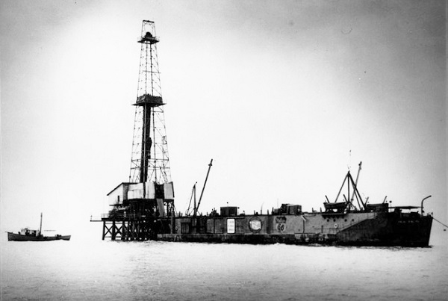
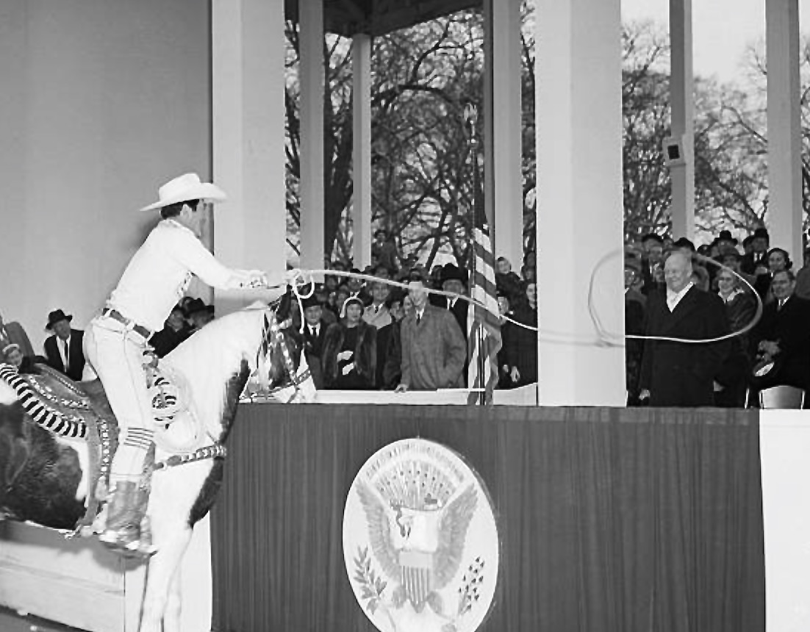
Why did OCSLA come to be?
March, 1938: 1st production in GOM
August, 1945: US lifted fuel rations the day after the end of World War II led to Harry Truman’s proclamation of federal authority over the OCS.
October, 1947: California, Texas and Louisiana defied proclamation and continues to issue leases. Supreme Court ruled against the states; federal government as possessing “paramount rights”. Meanwhile… Kermac 16 “out of sight from land” at 10.5 miles off the coast in Ship Shoal, used a war surplus barge to house mud/supplies & quarter workers.
May, 1953: After months of intense debate, and a 3-year stall (pause #1) of leasing and exploration, newly elected Dwight D. Eisenhower signed compromise legislation validating all state leases awarded before the Supreme Court decision and reserved 3 states coastal land within 3 nautical miles (3 marine leagues for Texas and Florida). Where’s Texas?
July, 1953: OCSLA was signed as a compromise.
3
Notes:
Well, to summarize: soaring demand for domestic oil and gas post WW2, proven production offshore moves away from the coastlines, and territory wars between the states and feds. That’s why.
In 1938 – the first production from Gulf was established. This went under the oil and gas news radar as interest was directed elsewhere to: Mexico who nationalized its oil industry and Standard Oil announced its first discovery well in Saudi the same year.
By 1945 – the conclusion of WW2 meant the US lifted fuel rations the day after Japan’s surrender ending the Pacific War led to President Harry Truman’s proclamation of federal authority over the OCS.
California, Texas and Louisiana all defied this proclamation in 1947, but were defeated in the Supreme Court’s decisions that the federal government possessed “paramount rights” to the OCS.
In the same year, the famous Kermac 16 well was drilled by Kerr-McGee, out of sight from land – 10.5 miles offshore doesn’t sound far away now, but think about it – that was still in 30’ water depths – where workers and supplies can’t touch the bottom and now you’re out swimming distance! Kermac used war-surplus barge to house mud and supplies and quarter workers offshore.
1953 – after months of intense debate over the jurisdiction issue – endless hearings held by Congress resulted in a 3-year stall of all leasing and exploration offshore, even putting the offshore rights at the top of the presidential campaign agendas, newly elected Dwight D. Eisenhower signed compromise legislation awarding state leases that had been previously awarded before the Supreme Court decisions in 1947 and 1950, and reserving rights to the adjacent states within 3 miles of their shore, except for Texas and Florida who were later able to obtain three leagues based on historical claims. Eisenhower famously joked “Where’s Texas?” when he signed the bill into law because his vote was only the second time Texas had voted Republican and largely because of his support of the state’s offshore claims.
By July 1953 – OCSLA was signed and we were back to the races offshore.

Slide 6
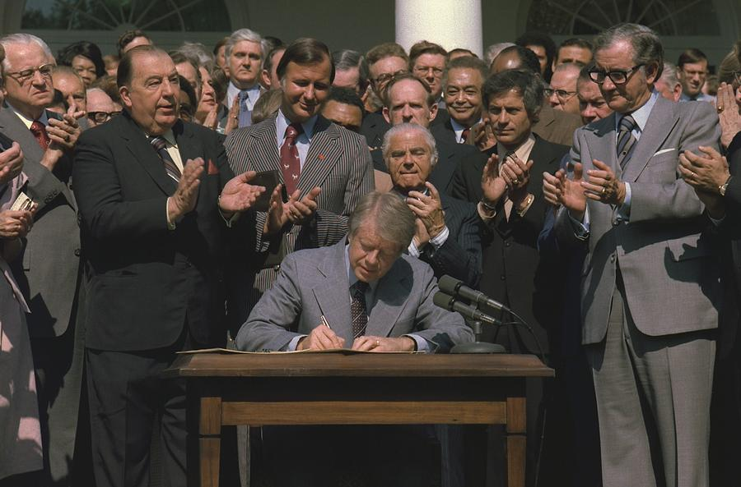
1978 Amendment
The Secretary of Interior prepares and revises 5-year oil and gas leasing program.
Expanded role of state and environmental agencies.
Companies awarded leases prepare plans to explore, develop, and decommission the lease.
Leasing program is a schedule of lease sales; includes size, timing, leasing activity to best meet national energy needs in upcoming: five-year period.
3
Notes:
Signed by Jimmy Carter, the 1978 Amendment to OCSLA provided structure around how lease sales would be determined by allowing the Secretary of the Interior to prepare and revise 5-year leasing programs.
Since then, we have had 10 5 year programs, no gaps until this past one – which was set to end in 2022, the amended schedule ended in 2023.

Slide 7
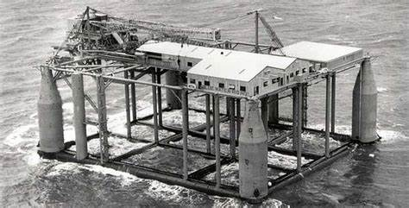
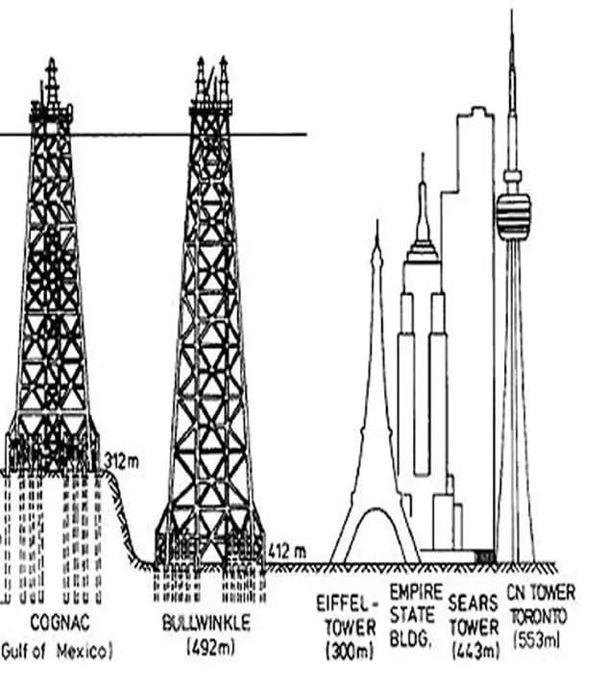
What led to1978 Amendment?
Exorbitant cost brings enhanced innovation: Wildcat wells drilled from fixed platforms = limited mobility, high risk and cost + how to produce?
1954, ODECO’s Mr. Charlie is first “submersible” drilling barge and Zapata Offshore develops “jack-up rig”.
1962, Shell’s Blue Water 1 - floating drilling platform and Eureka - dynamically positioned drillship in 600’-4000’ led to “School for Industry”.
1969, improved soil boring techniques, steel jacket construction advances, digital computers 3-D modeling for jacket designs.
1970s, fixed producing platforms rival heights of NYC’s tallest skyscrapers!
9x larger than onshore wells. 1962: 915,000 bopd – 8.6% of US production.
Insurance limits soar: hurricane damage and safety sacrificed.
1960 and 1962 lease sales; greater than all previous sales combined and 1974 lease sale brings a $2.17B in bonuses.
High-paying jobs offshore and in onshore support centers: New Orleans, Morgan City, Lafayette, Beaumont, and Houston.
Blue Water 1 – first submersible platform.
3
Notes:
In a nutshell – the 1978 Amendment came to be because of soaring costs, intense competition at sales, safety and environmental incidents resulted in a desire for more oversight.
Those initial wildcat succeses were all from fixed platforms – so the priority became reducing initial drilling costs and bringing about flexibility - Navy veteran Doc LaBorde built a $2MM drilling barge that was sunk and set on the sea floor in water less than 30’, and then refloated and moved elsewhere. This first submersible drilling vessel also set a precedent for the “day rate”.
As giant salt domes were recognized, companies like California company – Chevron, Magnolia – Mobil, and Humble Oil made huge discoveries – the hunt was on. Enter the Jack-up rig innovation, developed by companies including famously George H. W. bush’s Zapata Offshore. My 1957 23 mobile units were operating.
Between 1949 and 1056 the offshore discoveries being made were 9x larger than onshore. The size and scope – not to mention risk, of these projects led to insurance limits soaring. The frantic pace pushed boundaries and led to jack-up rigs capsizing in rough seas, Shell losing the drilling vessel in Hurricane Audrey after it spent $1MM drilling a dry hole, and increasing concerns about underwater pipelines – mechanically and legally as they crossed into state territory. Many left, certain that offshore exploration had reached its limit. And, finally, in 1960 and 1962 we had the biggest lease sales – biggest than all previous sales combined.
By 1973 there were 2800 producing platforms – many rivaled the heights of the tallest skyscrapers in the New York City.

Slide 8
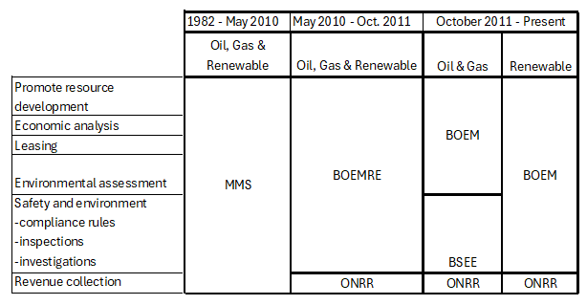
Agency responsibilities & timeline
Source: DOI
Notes:
Government agencies are critical to conducting all offshore oil and gas activities.
Prior to the blowout of BP’s “Macondo” well, the MMS – Minerals Management Service was in charge of all leasing, permitting and royalty collection for the OCS, however, after Macondo in May 2010 BOEMRE – Bureau of Ocean Energy Management, Regulation and Enforcement was formed separate from ONRR – the Office of Natural Resources Revenue to ensure fair collection of royalties and revenue. Then, after October 1, 2011, BOEMRE was divided in two: BOEM – Bureau of Ocean Energy Management who oversees lease sales, economic analysis, promotion of resource development – including the preparation of the environmental assessments and BSEE – Bureau of Safety and Enviornmental Enforcement who controls permits, inspections, investigations of incidents, enforcement of compliance, and ultimately managing the development of the Nation’s offshore resources in an environmentally and economically responsible way.

Slide 9








Decision makers
President
Donald Trump
January, 2025
Secretary of Interior
Doug Burgum
February 2025
Deputy Director – BOEM
Walter Cruikshank
January 2025
(Acting) Director – BSEE Paul Huang
February 2025
Notes:
So, who are our key decision makers? Well, unless you’ve been living under a rock, you know that we have had a recent changing of the guard.
Donald Trump – back in office as President. He has a critical role of signing off on 5-year leasing programs, not to mention signing executive orders to promote the development of our oil and gas resources.
Doug Burgum was appointed Secretary of the Interior this month – he is a businessman in the tech industry, who was also the governor of South Dakota, and left his commercial positions to serve as an advisor for Donald Trumps energy policy in December 2023.
Walter Cruikshank – once again Deputy Director – as of January 2025 and has been appointed into this role intermittently since the establishment of BOEM in 2011. Dr. James Kendall is the appointed regional director of the Gulf of America – he spent 11 years as regional director for Alaska and has an extensive background in environmental oceanography and marine biology.
Finally Paul Huang – acting director for BSEE – formerly with the Federal Insurance for the National Flood Insurance Program (NFIP) at FEMA. And lastly Bryan Domangue – appointed as Regional Director of the Gulf of America in August 2022 – an engineer with extensive experience within the region and with BSEE.
There are many employees of BOEM, BSEE and ONRR that we interact with daily and who we appreciate as knowledgeable and helpful.

Slide 10
Historical 5-Year Leasing Program: 2017-2022
 | Sale Number | Area | Year
1. | 249 | Gulf of Mexico Region | 2017
2. | 250 | Gulf of Mexico Region | 2018
3. | 251 | Gulf of Mexico Region | 2018
4. | 252 | Gulf of Mexico Region | 2019
5. | 253 | Gulf of Mexico Region | 2019
6. | 254 | Gulf of Mexico Region | 2020
7. | 256 | Gulf of Mexico Region | 2020
8. | 257 | Gulf of Mexico Region | 2021 (2022)
9. | 258 | Cook Inlet | 2021 (2023)
10. | 259 | Gulf of Mexico Region | 2021 (2023)
11. | 261 | Gulf of Mexico Region | 2022 (2023)
Now IRA Lease Sales
 | Sale Number | Area | Year
1. | 262 | Gulf of Mexico Region | 2025
2. | 263 | Gulf of Mexico Region | 2027
3. | 264 | Gulf of Mexico Region | 2029
Source: Boem.gov
Notes:
Since 1978, there have been 10 5-year leasing programs with no gaps. That is – until 2022 ended the last program and the planned IRA lease sales which replaced the regular 5-year plan. This is a marked difference in the number of sales and scope of the sales with only 3 lease sales currently planned for every other year – rather than the typical 2 sales per year.

Slide 11
Lease Sale: government perspective

Slide 12
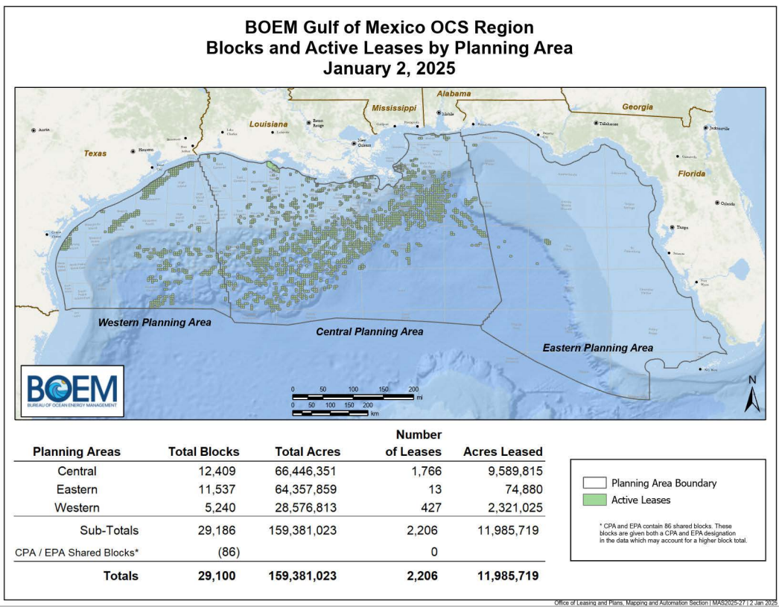
Notes:
This map is a close-up of the Gulf of America and its 3 planning areas: western, central and eastern. The green shows blocks currently under lease.
Of the total 159MM acres within the planning area, only about 12MM acres are leased with 2,206 leases.

Slide 13

Publishing a Lease Sale
Proposed Notice of Sale: BOEM posts 120 days before sale
Time/date of sale
Description of the sale area, lease terms and conditions, information to lessees, maps and bidding instructions
Final Notice of Sale: BOEM posts 30 days before sale
Includes a list of all available blocks.
Read closely in order to be aware of any changes to bid procedures.
Potential bidders must qualify to bid at sale.
Leases are offered on a “sealed bid” basis.
39
Notes:
To publish a lease sale, BOEM will post a Proposed Notice of Sale about 120 days before the lease sale showing all the terms and conditions and process for the sale, and then a Final Notice of Sale 30 days before the lease sale showing all the available blocks.
The Final Notice of sale also spells out all the lease terms and bid submittal process and includes templates for the submittals. So, it is a key document to review.
Potential bidders must qualify to bid at a sale.
And all bids must be in a sealed envelope when submitted.
At the lease sale bid reading, all bids are read aloud. This is the exciting part – seeing what competition occurred on each block and the companies involved with the sale.

Slide 14

Bidding at a Lease Sale
Each bid is submitted in a sealed and labeled envelope.
Bids sent by courier/mail and received by 10:00 am the day before the sale, along with:
Bidding Information Form
Affirmative Action Forms
GDIS Statement and Table
Bids are opened and read aloud by livestream on boem.gov
39
Notes:
At the lease sale bid reading, all bids are read aloud. This is the exciting part – seeing what competition occurred on each block and the companies involved with the sale.

Slide 15

Why Livestream?
39
Notes:
March, 2016 lease sale erupted with protests.

Slide 16
Covid-19 changes
Before Covid-19
Paper submittals; mail/courier delivery unheard of.
No electronic signatures.
In person lease sale bid drop-offs.
E-mail was an unofficial method of communication.
After Covid-19
Only courier or mail submittals accepted.
Email becomes an official method of communication.
No entry allowed into the BOEM office for bid drop-off or questions prior to sale.
Notes:
We courier bids now, but we didn’t always. Covid left a wake at BOEM – as it did everywhere. I’d argue that some of these changes weren’t all bad. Before 2020, electronic signatures were not accepted, email not an official form of communication with BOEM, and mailing or Fed-exing bids was unheard of. Now, not quite 5 years later, electronic signatures and email submittals for most BOEM documents is the norm, and hand-delivering bids has been prohibited. This has changed many of our basic practices when it comes to lease sale – eliminating much of the paperwork and mailings, but it has also required that processes be updated to ensure adequate review and tracking.

Slide 17
Acceptance, rejection, or return of bids
The United States reserves the right to reject any and all bids. No bid will be accepted, and no lease for any block will be awarded to any bidder, unless:
1. Bidder complies with Final Notice of Sale, including sample documents and applicable regulations.
2. Bid is the highest valid bid
3. Amount of the bid determined to be adequate.
Any bid submitted that does not conform to the requirements of the Final NOS, OCSLA, or other applicable statute or regulation will be rejected and returned to the bidder.
The U.S. Department of Justice and the Federal Trade Commission will review the results of the lease sale for antitrust issues prior to the acceptance of bids and issuance of leases.
39
Notes:
The United States reserve the right to reject any and all bids. Bids must comply with the Final Notice and its sample documents, must be the highest valid bid, and must be determined as adequate before the bid will be awarded.
If you weren’t already convinced of why we take our lease sales so seriously – this should help!
The US Department of Justice and Federal Trade Commission will review the results of the lease sale for antitrust issues prior to the acceptance of bids and issuance of leases.
I remember one time after handing in my set of bids – and no – I wasn’t a baby landman either – I heard a BOEM staff member say “Man – she was nervous!” uh-huh. Yes – I was. Not that the bid amounts were wrong, or that the wrong block was on the envelope. No – I’d checked those ad nauseum. I was fretting of that typo that would be uncovered during the bid reading – and somehow invalidate my bid.

Slide 18
Evaluation of High Bids
Office of Resource Evaluation evaluates high bids; ensuring the U.S. Government receives fair market value. BOEM conducts a two-phase review of the high bids.
Phase 1: all bids are reviewed for viability. Bids awarded only with zero geologic or economic viability.
Phase 2: detailed geologic and geophysical evaluation and discounted NPV model to determine MROV.
Notes:
But, even after all the bids are validated, the high bids are not automatically awarded. No – no. This is when the Office of Resource Evaluation conducts their bid adequacy 2-step to make sure that bids receive fair-market value. Phase 1 determines geologic and economic viability Only bids with zero probability of being explored, developed, and produced profitably under economic conditions present are accepted.
Phase 2 is a full geological and geophysical review. BOEM uses a discounted cash flow analysis to calculate the tract’s mean range of values (MROV). The MROV is the mean of a tract’s net present value of the oil and gas resources, adjusted for the geological risks of not finding hydrocarbons, the uncertainties associated with the tract’s development, and economic parameters at the time of the lease sale. MROV represents the maximum cash payment that a bidder can offer for acquiring the tract’s drilling and development property rights and expect to make a normal rate of return on its investment.

Slide 19
Rejected bids: 2000-present
CGOM/ EGOM Sales
Date | Sale No. | Rejected Bids | % Rejected Bids
3/1/2000 | 175 | 10 | 2.9%
3/1/2001 | 178 | 13 | 2.4%
3/1/2002 | 182 | 15 | 3.0%
3/1/2003 | 189 / 185 | 16 | 2.8%
3/1/2004 | 190 | 14 | 2.5%
3/1/2005 | 194 / 197 | 19 | 4.4%
3/1/2006 | 198 | 12 | 3.0%
3/1/2007 | 205 | 18 | 2.5%
3/1/2008 | 224 / 206 | 11 | 1.8%
3/1/2008 | 208 | 19 | 5.5%
3/1/2010 | 213 | 19 | 4.1%
3/1/2013 | 227 | 13 | 4.1%
3/1/2014 | 225 / 231 | 5 | 1.5%
3/1/2015 | 235 | 8 | 4.7%
3/1/2016 | 226 | 7 | 5.5%
3/1/2017 | 247 | 10 | 6.1%
 |  | 13.06 | 3.5%
WGOM Sales
Area-Wide Sales
Date | Sale No. | Rejected Bids (#) | Rejected Bids (%)
8/1/2000 | 177 | 7 | 3.1%
8/1/2001 | 180 | 7 | 2.2%
8/1/2002 | 184 | 7 | 2.2%
8/1/2003 | 187 | 5 | 1.5%
8/1/2004 | 192 | 4 | 1.1%
8/1/2005 | 196 | 0 | 0.0%
8/1/2006 | 200 | 10 | 2.6%
8/1/2007 | 204 | 8 | 2.8%
8/1/2008 | 207 | 6 | 1.9%
8/1/2009 | 210 | 7 | 4.3%
12/14/2011 | 218 | 9 | 4.7%
11/1/2012 | 229 | 0 | 0.0%
8/1/2013 | 233 | 2 | 3.8%
8/1/2014 | 238 | 1 | 1.2%
8/1/2015 | 246 | 0 | 0.0%
 |  | 4.87 | 2.1%
Date | Sale No. | Rejected Bids (#) | Rejected Bids (%)
3/1/2018 | 250 | 9 | 6.1%
8/1/2018 | 251 | 3 | 2.1%
3/1/2019 | 252 | 14 | 6.2%
8/1/2019 | 253 | 4 | 2.6%
8/1/2016 | 248 | 0 | 0.0%
8/1/2017 | 249 | 7 | 7.8%
3/18/2020 | 254 | 8 | 11.3%
11/18/2020 | 256 | 7 | 7.5%
11/17/2021 | 257 | 0 | 0.0%
3/29/2023 | 259 | 14 | 4.7%
12/20/2023 | 261 | 12 | 4.0%
 |  | 7.1% | 4.7%
Notes:
Mostly out of nerdy curiosity, I thought I’d check-out the average number of rejections per sale. Something to keep in mind, especially as the number of companies participating has waned over recent years. Most recently in 2020, the rejection rate in area-wide GOM sales had bid rejections of 11.3% of total high bids and 7.5%. Followed by 0%, which is when all bids were awarded pursuant to the IRA.

Slide 20
Restricted bidders
BOEM places regulatory restrictions on joint bidding by publishing a List of Restricted Joint Bidders.
Each entity within one of the following groups is restricted from bidding with any entity in any of the other following groups at an OCS lease sale during a specified timeframe.
Most recent groups of restricted joint bidders:
BP | Chevron
Eni | Equinor
ExxonMobil | Shell
Total
Notes:
Twice yearly, BOEM reviews its list of restricted joint bidders. Fortunately, this list doesn’t change often. Currently it consists of BP, Chevron, Eni, Equinor, ExxonMobil, Shell, and Total who cannot joint bid per the Energy Policy and Conservation Act of 1975 or those companies producing more that 1.6MMBOE.

Slide 21
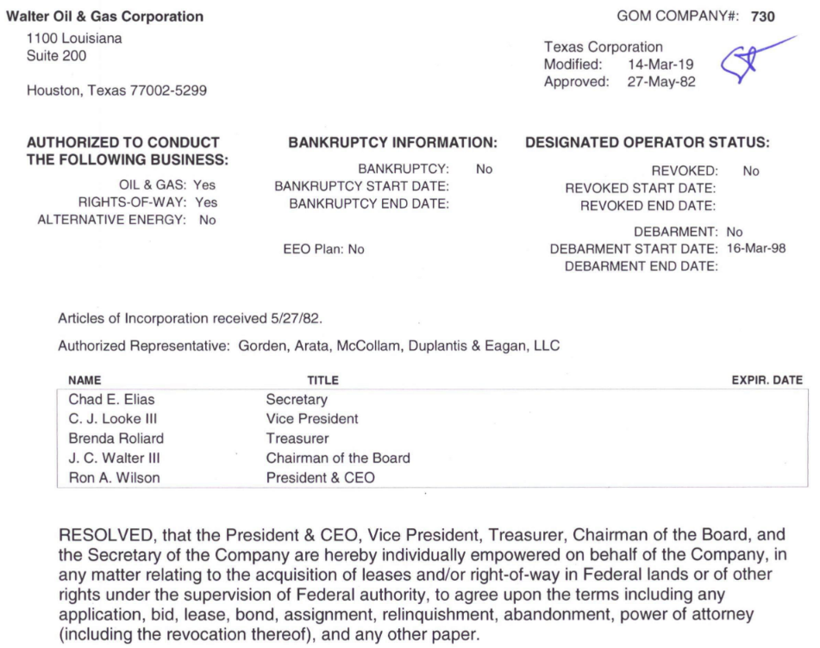
Qualification requirement
Submit required information/documents to BOEM. Company changes must be documented.
Certify with corporate seal to establish qualification of a corporation.
Only qualified companies can operate, lease, or participate in OCS operations.
Notes:
We talked about qualified bidders at lease sale. This slide discusses how a company or person becomes qualified.
By submitting all requisite information and meeting all requirements, BOEM will grant approval in the form a qualification card containing the qualification number. This number will be referenced in all submissions to BOEM, BSEE and ONRR.

Slide 22
Not Available for Leasing
Gulf of Mexico Energy Security Act of 2006 (GOMESA) restricted OCS blocks from oil and gas leasing.
Eastern Gulf of Mexico within 125 miles of Florida & east of 86 degrees, 41 minutes west longitude
A portion of the Central Gulf of Mexico within 100 miles of Florida.
A portion of the Alaskan Arctic; 25-mile coastal buffer and Hanna Shoal in the Chukchi Sea; and Barrow and Kaktovik whaling areas in Beaufort Sea by President Obama on January 27, 2015.
All National Marine Sanctuaries were withdrawn, for a time period without a specific expiration, by President Clinton on June 12, 1998.
Notes:
Yes. The Gulf of Mexico Energy Security Act of 2006 (GOMESA) placed portions of the Outer Continental Shelf (OCS) off-limits to oil and gas leasing through June 30, 2022. Specifically, leasing is prohibited in the Eastern Gulf of Mexico within 125 miles of Florida; all of the Eastern Gulf of Mexico east of 86 degrees, 41 minutes West longitude; and a portion of the Central Gulf of Mexico within 100 miles of Florida. Pursuant to Section 12 of the OCS Lands Act, on December 16, 2014, President Obama withdrew the North Aleutian Basin (including Bristol Bay) in Alaska, for a time period without a specific expiration, from consideration of leasing for the purposes of oil and gas exploration, development, or production. Also pursuant to Section 12 of the OCS Lands Act, on January 27, 2015, President Obama withdrew portions of the Alaskan Arctic planning areas from future oil and gas leasing consideration for a time period without specific expiration. These Presidential withdrawals included a 25-mile coastal buffer, subsistence use area, and the Hanna Shoal (lying within the contours of the 40-meter isobath) in the Chukchi Sea Planning Area and the Barrow and Kaktovik whaling areas in the Beaufort Sea Planning Area. Similarly, all National Marine Sanctuaries were withdrawn, for a time period without a specific expiration, by President Clinton on June 12, 1998.

Slide 23
Lease Sale: landman perspective
Notes:
Now the landman’s perspective on the lease sale.
As I mentioned before, many of you in this room are very familiar with lease sale processes and procedures, but it has been a while now since we had frequent and predictable sale schedules. Also, in general, the size of the last few sales was more pared down then past sales. So, in the hopes that lease sales pick up and become more regular with this administration, this part might serve as a refresher to some, and as a resources to those of you who are new to the gulf sales.

Slide 24
Landman’s Role in Lease Sale
The Landman’s responsibilities include:
Prospecting Lease Sale opportunities
Gathering data on open blocks and FNOS
Forming sale partnerships
Preparing for bid meeting
Executing and submitting bids - while ensuring compliance with bidding rules
Notes:
The landman’s role regarding lease sales is quite diverse – we get to wear lots of hats. We help lead the prospecting effort in sourcing prospects from third parties as well as within our own internal teams. We gather information and communicate internally about the open blocks, terms of the Final Notice, as well as stipulations or restrictions that might apply to a block of interest. Once we lay the initial ground work within the teams and develop a strategy with executive management, we get to work forming sale partnerships – looking for partners who align or have synergies with our companies. Then, once identified, we negotiate the Joint Bidding Agreement and associated agreements and prepare the bid meeting. Once we know what blocks we are bidding on and who we are bidding with, it becomes more of an administrative task to put the bids on paper and prepare the other documents that are required to execute and submit together with those sealed bids. The landman works with the geoscience and engineering, accounting and finance, management and administration teams along the way while keeping bid information extremely close to the vest. It’s a bit of a dance to get it all ready within usually a short period of time.

Slide 25
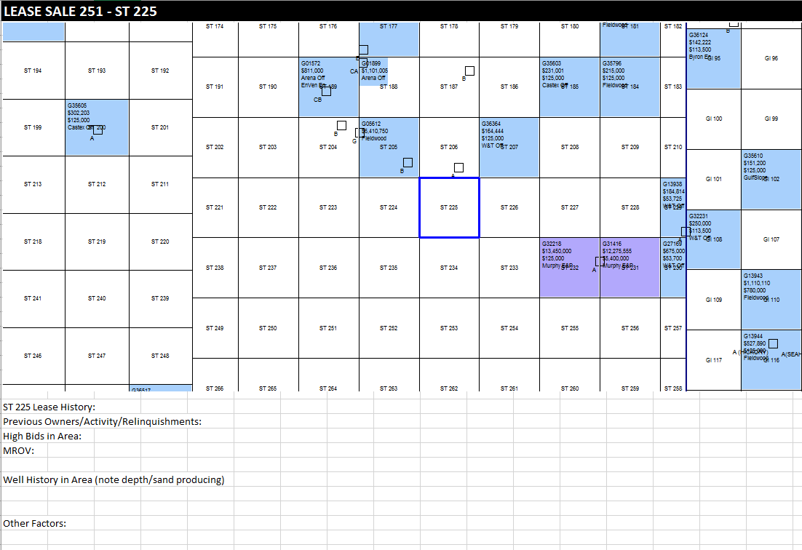
Landman Cheat Sheet
Notes:
Typically, I start off by preparing a cheat sheet for each block of interest. I’ll list the bid history, any MROVs or competitive bids, as well as previous and active owners in the area and well history on or near the block. I used to print these off, but now I generally just have them saved in a private file and can add notes as needed.

Slide 26
Existing AMIs/Buy-Back Provisions
Contract due diligence:
Before and after lease sale.
Check for AMIs & buy-back provisions in:
Confidentiality Agreements
Participation Agreements
Joint Operating Agreements
Joint Ventures/Exploration Agreements, Joint Bidding Agreements, Seismic Agreements, Letter Agreements, Amendments, Etc.
Next steps: comply/seek compliance.
Notes:
Checking for AMIs is another important bit of homework to do upfront. For each block before and after the sale – you’ll want to check your master list of restricted blocks – if you don’t keep a master, then the AMIs and buy-backs can be found in Cas, Pas, JOAs, and other joint venture agreements. If you identify any overlaps, then you can seek to determine how best to address them.

Slide 27
Confidentiality at the Lease Sale
Confidentiality of Bids
Sealed bids
# Bids in Deepwater/Shelf is collected by OOSA on Tuesday before Lease Sale.
“Highest Suggested Amount” for Joint Bids
Bid Meeting Procedures
Federal Anti‐Trust Language:
“It is not the intention of the parties hereto to restrict the right of any party to make a bid as to any of the blocks subject to this agreement and each party shall have the right to make any such bid on any block it may desire, including blocks for which bids are being considered or being made hereunder.”
Notes:
Confidentiality is paramount. Usually bid amounts, block information is kept limited to a very small group of people throughout the sale process. It helps if you decide as a technical team, how best to communicate lease sale information. Some companies are reluctant to share sale information by email, others don’t mind but want email limited to only certain people. Keeping sale information on a secure sharepoint site or separate drive can also protect confidentiality and protect people who may not be aware of the sensitivity. Sealed bids are how we keep the bids private from submission until the lease sale, with the exception of providing the number of deepwater vs. shelf bids to the Offshore Oil Scouts – who supply a list of bids from each company the evening before the sale.
Also, a common reference you’ll hear is “Highest Suggested Amount for joint bids. Federal anti-trust language requires that no party restrict the right of any party to make a bid on any block. This is a standard that industry has upheld consistently by careful negotiaton of Joint bidding agreements and bid meetings.

Slide 28

Antitrust – bid determination
Be aware that any move or action by any party to prevent any other party from bidding either alone or with any other third party or from bidding such higher amount as he/she wishes to bid, is a violation of the law
Review carefully with legal.
Cannot chill a bid.
Cannot negotiate a bid.
A joint bid must be the “highest suggested bid” at the final bid meeting.
Notes:
It means that as landmen we must be aware of any action by another party that would in any way prevent any other party from bidding alone or with any other 3rd party or from bidding a higher amount. Doing so would be in violation of the law. So, you cannot chill – or try to reduce a bid. You cannot negotiate a bid. And you must aim to put forth the highest suggested bid.

Slide 29
Bid determination process
Bid Charge lays out:
Referenced bidding agreement.
Company speaker for each company.
Exchange qualification and EFT information, preferable in advance.
Companies and participation interest (%) for each block. Interest (%) may only be reduced if approved by all bidding parties in said block.
Bidding is done using clockwise rotation.
Identify company to initiates bidding for a bid and bid increment. (Ex: minimum bid ($576K )and $1MM)
Each party will take an action when it is their turn. Actions include:
Concur and raise by the increment ($1.576MM)
Concur and pass ($576K)
Concur and recommend a final “highest suggested bid” to be rounded within the increment ($576K - $1.576MM - final)
Place the bid on hold
Request to reduce participation interest (%) in a bid
Request a reduction in the bid increment ($250K)
Elect not to participate (your company signs-out of memorandum, leaves room until next bid. Bid determination process continues)
Parties in agreement with the “highest suggested bid” evidence concurrence to participate and sign memorandums.
Notes:
At the bid meeting, each block is referenced on a “bid charge” which references the bidding agreement and sale number, who the company speaker is for each company, any applicable qualification or EFT information, and the companies and their working interest in that block.
This is one of the most unique meetings I’ve ever encountered in the business because it follows a very formal process to determine the bid amount, and it is set-up specifically not to deviate from that process. Usually only the company speakers attend the meeting, however, if there are others in the room, they are not permitted to speak or weigh in on the process.
Once the minimum bid and bid increment is set, Each company will have its turn in rotation to act upon the bid. These actions include: to concur and raise by the increment, to concur and pass, to concur and recommend a final highest suggested bid to be rounded within the increment, to place the bid on hold – if a call is needed to be made, a request to reduce the bid increment, reduce your companies working interest in the bid, and finally election not to participate.

Slide 30

Video: Bid Meeting
Notes:
Back in 2010, Mike Koenig, Becky Harden and John Burke, were kind enough to put this simulation together showing what the bid meeting looks like. It’s just about 90 seconds, so I’m going to play it for you, because it really is a good reminder of how this meeting works and why it is important. This is also a reminder of how much technology has changed in 15 years! Ha ha.

Slide 31
Landman’s Lease Sale Checklist
60 Days Before Sale:
Partner Formation / Bid Agreement Negotiation / Obligation Due Diligence
30 Days Before Sale:
Final Notice of Sale Review / Communicate Internally with Signor and Accounting, Bid Meetings
Friday Before Sale: (or earlier)
Check, Double-Check and Sign Bids and BOEM Submittals
Sale Day:
Verify high bids and pay 1/5 EFT funds due
Notes:
I’m going to go through the next few slides quite quickly, because these are a more detailed checklist of the landman’s responsibilities for lease sale, but please feel free to use this slide deck as a resources to help you with your own lease sale process. This checklist was also supplied back in 2010, I updated it for the OCS Advisory Board talk in 2020, but I was surprised at how many additional changes were needed in just the last 5 years. Namely, technological efficiencies have cut out certain steps, but also the changes to the actual regulations in the Final Notice.

Slide 32
LEASE SALE PREP CHECKLIST
TWO MONTHS BEFORE SALE:
1. Review Preliminary Notice of Sale: Advise technical team.
2. Bidding Agreements (CA, if applicable): signed before technical data is shared.
3. Landman Cheat Sheets for all possible bid blocks.
Check latest CA Master List for contractual block restrictions which affect any possible bid blocks.
Check files for any recent obligations not on Master Map/List.
4. Request partner company’s qualification.
Verify all parties’ qualification and Affirmative Action Forms (BOEM Form 2032 and 2033)
Check with legal to see if debarment updates are needed.
5. Schedule Bid Meetings.
*Only with Joint Bids

Slide 33
LEASE SALE PREP CHECKLIST
ONE MONTH BEFORE SALE:
6. Final Notice of Sale on boem.gov:
Review bid instructions. Note any changes from prior year.Review supplemental documents. (NTLs, Executive Orders, Website updates)
7. Prepare spreadsheet for all possible blocks and list the following:
Prospect
Area / Block / Minimum Bid
Royalty / Royalty Relief / Primary Term Extensions, if applicable
Primary Term / Map Number
Stipulations
Acreage / Water Depth
Rentals
Tentative Bid & Participation Interest
Verify that each block is available
Check formulas for 1/5 Bonus and 4/5 Bonus + 1ST Year Rental
AMI or obligations?
Add subsequent blocks, as needed.

Slide 34
LEASE SALE PREP CHECKLIST
8. Coordinate EFT or ACH for 1/5 bonus transfer. And with partners on their share.
9. Email BOEM to indicate your company’s lease sale representative. (boemgomrleasesales@boem.gov) ENSURE INTERNAL AUTHORITY SIGNOR IS AVAILABLE FRIDAY BEFORE SALE.
10. Verify Wire Transfer Requests with accounting / Confirm partners’ wire transfer information.
11. Get all parties corporate qualification directly from BOEM (or look for current date online).
12. Prepare blank bid form template, envelopes and memorandums you are responsible for (send to applicable partners for review).
13. Request blank bid forms, envelopes and memorandums from all partners responsible for joint bids.
14. Host Bid Meetings. Make sure all blocks in JBA are covered by memo (i.e. one‐way memo out, both out, both bid).
15. Prepare all Bid Envelopes and Bid Forms pursuant to Sale Notice and bid memos and check all envelopes and forms prepared by partners.
16. Prepare BOEM Form 2022 and 2023 and Bidders Information Form.
17. Prepare geophysical statement and work with technical team to prepare map/spreadsheet for all bid blocks and file at bid submission. Check to make sure partners are preparing like-wise for each joint bid block.

Slide 35
LEASE SALE PREP CHECKLIST
FRIDAY BEFORE SALE (or earlier…)
18. Confirm travel/hotel reservations to New Orleans.
19. Prepare two complete sets of bids:
Check (more than one person) both sets
Sign and scan each set separately and seal envelopes.
One original set of bids, GDIS, Affirmative Action forms, and Bidding Information Forms is sent by courier (keep tracking information) for Monday am (at the latest) delivery and keep one set for emergency backup.
20. Send email alerting BOEM when courier is sent (include tracking information)
21. Prepare a package containing partner financial contacts and ACH/EFT instructions and provide to Treasury.
22. Communicate delivery initiation and receipt to partners.
23. Sit back and pour yourself a drink!

Slide 36
LEASE SALE PREP CHECKLIST
DAY OF LEASE SALE
26. Watch livestream of Sale (boem.gov) and note competition on bid blocks and other blocks of interest. (compare with master obligation list)
27. Verify high bids and EFT funds due.
28. Finalize spreadsheet of the high bid blocks with amount of 20% due.
29. Send internal contacts update regarding successful bids and wire transfer.
30. Submit wire transfer and verify payment was made and received by BOEM and partners.
BEFORE ONE WEEK AFTER SALE
31. Prepare Sale file.
32. Prepare “Post‐Sale Analysis” summary spreadsheet for management.
33. Submit any CAs or JBAs internally for scanning and filing.
34. Compile all CA and/or JBA obligations created by Sale efforts; e‐mail to partners for verification.
35. Post all sale obligations to include in master obligation Map and List.

Slide 37
LEASE SALE PREP CHECKLIST
UPON LEASE AWARD
37. Notify appropriate departments and accounting as soon as leases are awarded.
38. Prepare and execute all required documents to be sent to BOEM.
A. Lease Form (Include Corporate Seal)
B. Designation of Operator Form (company designation to itself)
C. 1017 Form, if applicable.
39. Submit copies of all BOEM paperwork to partners.
40. Check fully executed lease and other required documents to see that signatures are correct and company seal is on lease.
41. Set up payment of 4/5 Bonus + 1st Year Rental with Treasury to pay before deadline on successful leases.
A. Send wire transfer, confirm wire and verify receipt.
42. Prepare Operating Agreement(s) if not already completed.

Slide 38
Lease Sale: terms and trends

Slide 39
OCS Lease Terms
Minimum Bonus Bid Amount:
$25.00 per acre (< 400 m)
$100.00 per acre (> 400m)
Royalty Rate:
18.75%
Primary Terms
< 400m: 5 years + 3 year extension (wells >25,000’ TVDSS)
400m-800m: 5 + 3 years (well spud required)
800m +: 10 years
Extension require timely notification in accordance with lease.
Rental Rates per Acre
Water Depth (m) | Years 1-5 | Years 6, 7, 8
0 to <200 | $10 | $20, $30, $40
200 to <400 | $16 | $32, $48, $64
400+ | $16 | $22
Escalating rental rates apply during 3-year extension of primary term.

Slide 40
Primary Term (2000 – present)
Notes:
Primary term lengths have been reduced except for deepwater blocks, which have stayed consistent at 10 years.

Slide 41
Minimum Bid / Acre (2000 – present)
Notes:
Minimum bids per acre has stayed mostly flat except for an jump from $40 to $100 per acre on deeper water leases back in 2010. But, since the government does not rely on minimum bids for adequacy, this is a very loose guide that doesn’t factor in whatsoever in bid adequacy.

Slide 42
Royalty Rate
Notes:
Royalty rates have stayed flat since 2007 except for the dip we experienced dropping royalties on shallow water leases to 12.5% for 5 years.

Slide 43
Rental Rate (2000 – present)
Notes:
Rental rates per acre have increased dramatically, with a recent jump from $63K per lease per year to $92K. That jump from $10 per acre to $16 was significant, but these charts aim to show that the bigger jump was actually the extended year rentals with $66.acre/year to hold the lease is intended to motivate companies to relinquish leasese they don’t intend to drill.

Slide 44
Sum of High Bids (2000 – present)
Notes:
Finally, to conclude: This slide shows the scale of high bids received per sale on the left axis compared with number of companies participating. The charts on the left show the Central and Eastern sales on top and Western sales on bottom from 2000 – 2017 and then the area-wide sales on the right. The scales for these charts are much different – as you can see. The highest sale on record for this timeframe was Lease Sale 206 MMS received 1,057 bids from 85 companies on 615 tracts resulting in a record $3,677,688,245 in high bids. The high bid block at that sale was GC 432 for $105.6 MM by Anadarko, Murphy and Samson, which was competitively bid with 3 bids. Companies have bid more conservatively since the 2015 dip in oil prices, but by the bigger change has been the number of companies participating in sales. Mergers and sales and exits have definitely impacted the number of active companies, but there was an uptick of 29 bidders in the last sale and an upward trend since 2020.
That concludes my talk today. Thank you!

Slide 45
The End: any questions?

Slide 46
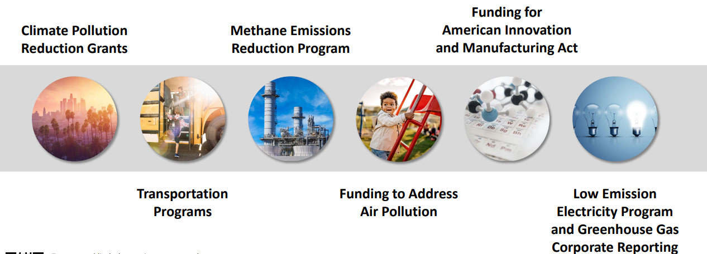
Inflation Reduction Act refresher
Source: whitehouse.gov
Notes:
What did the IRA have to do with our 5-year leasing program? Quick refresher – it was intended to cover things like climate, reduction of emissions, and improvement of

Slide 47
Inflation Reduction Act – August 7, 2022
Previous announced offshore lease sales to be held during the next 2 years, despite the 5 Year Leasing Plan expired in June, 2022. Lease Sales 258, 259, 261
High bids awarded from Lease Sale 257, which had been vacated due to U.S. District Court ruling that environment review was inadequate. Friends of the Earth v. Haaland, 2022
New offshore wind lease sales require that at least one offshore oil and gas lease sale (60 million acre min.) be held within the year prior to the new offshore wind sale.
Coming soon: date for lease sale 262.
Notes:
The 1978 Amendment of OCSLA provided for five year leasing programs. The leasing program is a schedule of all lease sales within a 5 year period and they include details around the size, timing and location of the leasing activity, as approved by the Secretary and ultimately signed by the President of the United States.
Lease sales covering the Western and Central planning areas are typically held twice each year, in March and August.
We are currently operating in the 2017 – 2022 leasing program, which has been challenged since Joe Biden stepped into office. Now that we’re wrapping up this 5-year leasing program, there is even more uncertainty about the timing, offering, and frequency of future lease sales.

Slide 48


Rice Whales
New addition to endangered species with migratory territory across GOM.
Rice Whale unique to region?
National Marine Fisheries Service (NMFS) found 27 threats to Rice Whales in 2020 biological opinion (BiOp)
Lease Sale 261 included stipulations and excluded migratory territory; sale was subsequently delayed (twice) and rescheduled on December 20, 2023.
Sierra Club v. NMFS, District Court of Maryland ruled violations and vacated BiOp in December, 2024.
Notes:
NMFS biological opinion in 2020 found 27 threats to whales
In August, 2024: although a stay had been put in effect since 2023, requiring BOEM to implement protective measures for the whales, Sierra Club v. NMFS was brought to the District Court of Maryland. This court ruled the BiOp violated both the Endangered Species Act and Administrative Procedure Act and vacated the BiOp in December, 2024. Oil and gas intervenor-defendants and the State of Louisiana successfully challenged the inclusion of two measures in LS 261 in Federal District Counrt and the stay was lifted.
In October, 2024: Maryland Federal Court extended effective date to May 21, 2025. API and other intervenors argued the vacatur would have disastrous consequences including serious curtailment or halting GOM production.
The court’s decision vacating the BiOp found that the BiOp underestimated the risk and harms of oil spills to protected species; that the jeopardy analysis improperly assumed that the Rice’s whale and Gulf sturgeon populations remained as large as they were before the Deepwater Horizon oil spill; that the “reasonably prudent alternative” addressed only two stressors likely to jeopardize the Rice’s whale; and that the incidental take statement failed to recognize oil spill take as incidental take and did not rationally quantify the number of listed species taken by vessel strikes.
Results are: increasing monitoring whale activity, reduced boat speeds, 500m separation, identification of vessels 65’ or greater, and reports of all vioations to BSEE.

