Slide 1
Going the Way of the Neanderthals Why the Current Energy Transition May Soon Be Extinct

Slide 2

Shameless Propaganda

Slide 3



The Landman Powered by
Savvy
Master negotiators
Tough
Faces danger head-on, from rigs to drug cartels
Adaptable
Juggles high-stakes deals and family drama on the fly
Resilient
Thrives in chaos – handles crises with grit

Slide 4

Thank You to Our Sponsor
Michelob Ultra
The Official Non-Alcoholic Beverage of Landmen Everywhere

Slide 5


Oil & Gas Attorney
Hollywood
Real World

Slide 6


Oil & Gas CEO
Monty
Mike
Real World
Hollywood

Slide 7
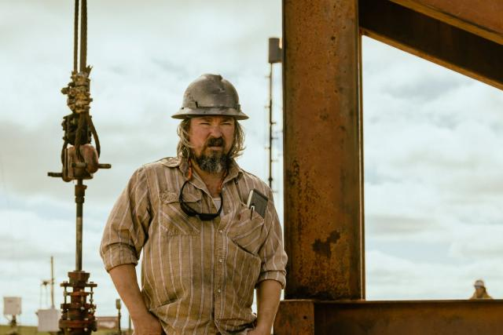
Reservoir Engineer
Hollywood
Dale

Slide 8

Reservoir Engineer
Real World
Milton

Slide 9
Survival of the Fittest

Slide 10
Why Did the Neanderthals Vanish?
 | Neanderthals | Homo sapiens | Advantage
Time period | ~400,000 – 40,000 years ago | ~300,000 years ago to present | Neanderthal (1st Mover)
Brain Size | 1,200 – 1,750 cm³ | 1,200 – 1,400 cm³ | Neanderthal
Strength | ~20 – 30% Stronger Stocky | Taller | Neanderthal
Adaptability | Stone tools (limited) | Innovative tools (more flexible) | Homo Sapiens
Homo Sapiens’ Superior Ability to Adapt to Change
Outcompeted the Smarter, Stronger Neanderthals

Slide 11
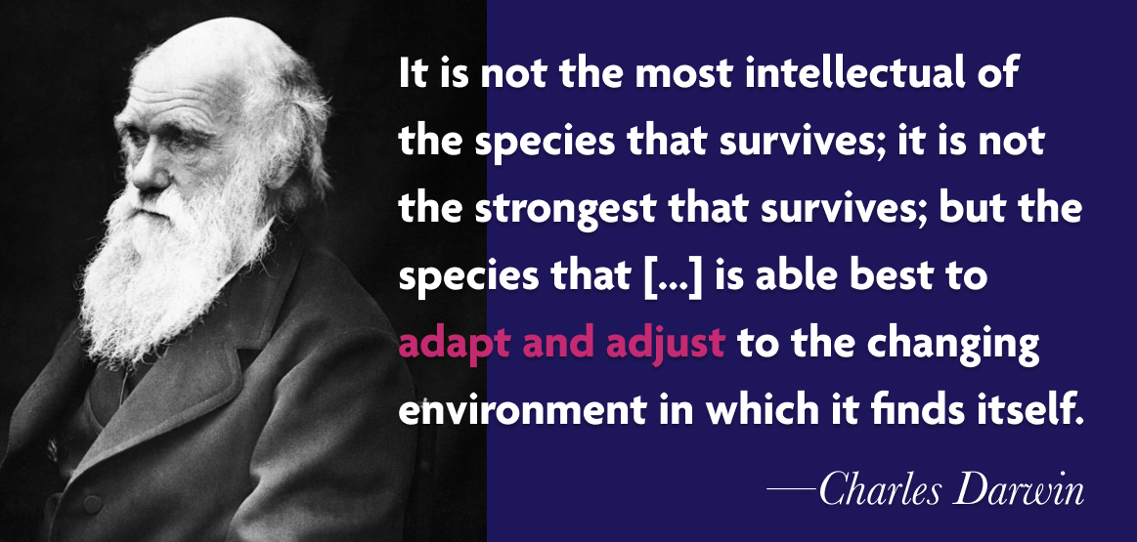
Technology is Mankind’s Evolutionary Superpower
Notes:
Unlike Neanderthals, who had strength and basic tools but stuck to a narrower playbook, humans turned sticks into spears, rocks into blades, and eventually ideas into machines.
It’s like we’re the Swiss Army knife of species: not the toughest or sharpest out of the box, but endlessly tweakable for any situation.
This knack for inventing and refining tools let us conquer everything from Ice Age winters to outer space, proving Darwin’s point—adaptability, not brute force, is our edge.

Slide 12
Survival of the Most Adaptable to Change
Technology is Power
Agriculture birthed cities and guns toppled empires
Energy Feeds Technology
Technology needs reliable, affordable, and secure energy
Competition for Resources Determines Winners & Losers
Europe’s Industrial Revolution vs. resource-poor regions
Societies that harness technology to adapt don’t just survive—they redefine the game,
leaving others in history’s dust

Slide 13
Homo Faber’s Anthropological History
Era | Time Period | Length | New Technology | Primary Energy Sources | Food Productivity (Fed / Worker) | Worker Productivity (MJ / Day)
Paleolithic | ~2.5M–10,000 years ago | ~2.5 Million Years | Stone tools, Fire | Human muscle, fire | ~0.5–2 | ~1 – 2
Mesolithic-Neolithic | ~10,000–3,000 BC | ~7,000 years | Agriculture, pottery | Human/animal muscle, fire | ~2–5 | ~2 – 5
Bronze Age | ~3,300–1,200 BC | ~2,100 years | Bronze tools/ weapons, writing, wheel | Human/animal muscle, fire | ~3–10 | ~5–10
Iron Age | ~1,200 BC– 500 AD | ~1,700 years | Iron tools/weapons, advanced metallurgy | Human/animal muscle, fire | ~5–10 | ~10–15
Classical Antiquity | ~500 BC– 500 AD | ~1,000 years | Aqueducts, concrete, mechanical devices | Human/animal muscle, water/wind | ~10–20 | ~15–25
In 2.5 Million Years of Evolution Human’s Increased Productivity 25X
Notes:
1 Megajoule = 1,000,000 joules, 240 calories of energy expended
Swinging a hammer all day would be 1 – 2 MJ of energy
Gallon of gasoline has 120 MJ

Slide 14
Homo Faber’s Anthropological History
Era | Time Period | Length | New Technology | Primary Energy Sources | Food Productivity (Fed / Worker) | Worker Productivity (MJ / Day)
Middle Ages | ~500–1500 | ~1,000 years | Windmills, waterwheels, printing press | Human/animal muscle, water/wind | ~10–20 | ~25–50
Early Modern | ~1500–1800 | ~300 years | Gunpowder, navigation tools, steam engine | Human/animal muscle, wind, coal | ~20–35 | ~50–100
Industrial Age | ~1800–1950 | ~150 years | Steam engines, electricity, machinery | Coal, steam, oil, electricity, natural gas | ~50–100 | ~1,000–10,000
Modern/ Atomic Age | ~1950–present (2025)** | ~75 years | Computers, nuclear tech, renewables | Oil, natural gas, nuclear, coal, solar, wind | ~200–1,000 | ~10,000–100,000
In Last 1,500 Years, Productivity has Scaled to 10,000 – 100,000 Times Over Our Paleolithic Ancestors
Notes:
1 Megajoule = 1,000,000 joules, 240 calories of energy expended
Swinging a hammer all day would be 1 – 2 MJ of energy
Gallon of gasoline has 120 MJ

Slide 15
Observation 1: Pace of Change is Accelerating

Slide 16
Observation 2: Food Productivity Provides Labor Freedom

Slide 17
Observation 3: Productivity Growth Rate is Accelerating

Slide 18
Why the Current Energy Transition May Soon Be Extinct

Slide 19
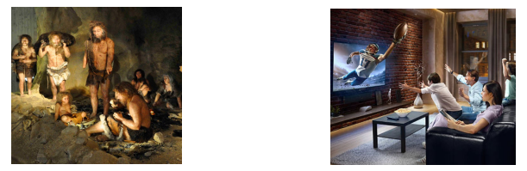
Information is the Only Thing Different Today
Technology Provides Survival, Safety, Speed,
Convenience, Comfort, Beauty, Entertainment
Affordable
Reliable
Useful
Technology
Adoption
Paleolithic Era
Modern Era

Slide 20
Humans Invent Energy Demands
Energy Use Per Decade per $1 Billion Invested
Cars
$200 MM
Oil
Planes
$300 MM
Oil
Chip Factories
$300 MM
Electricity
Datacenters
$600 - $2,000 MM
Electricity

Slide 21
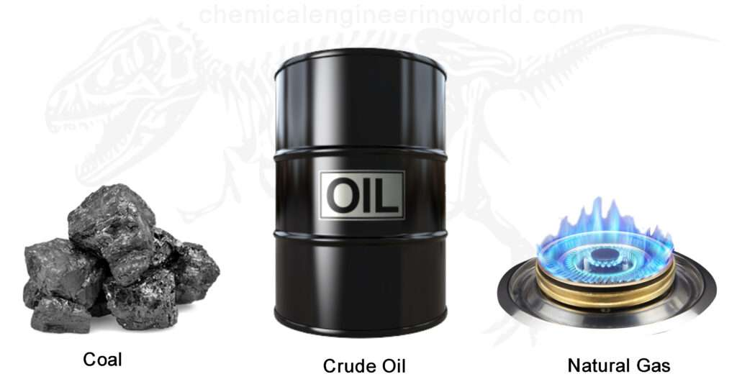
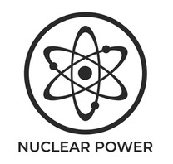
Energy Hierarchy of Needs
Preference
Clean Air and Water
Reliable
(24/7/365)
Low Carbon
Affordable, Secure
Requirement

Slide 22
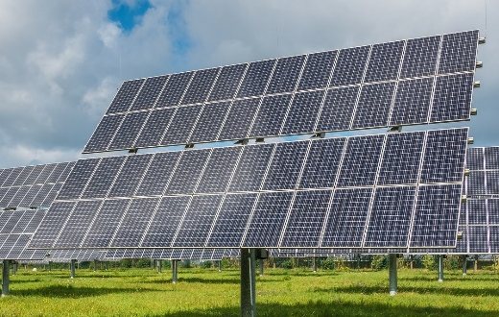
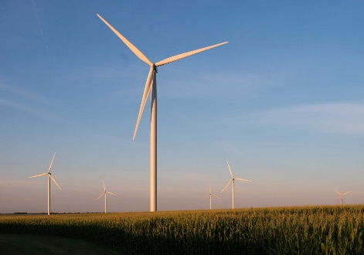
Energy Transition Wants to Invert the Hierarchy
Requirement
Clean Air and Water
Reliable
(24/7/365)
Low Carbon
Affordable, Secure
Preference

Slide 23
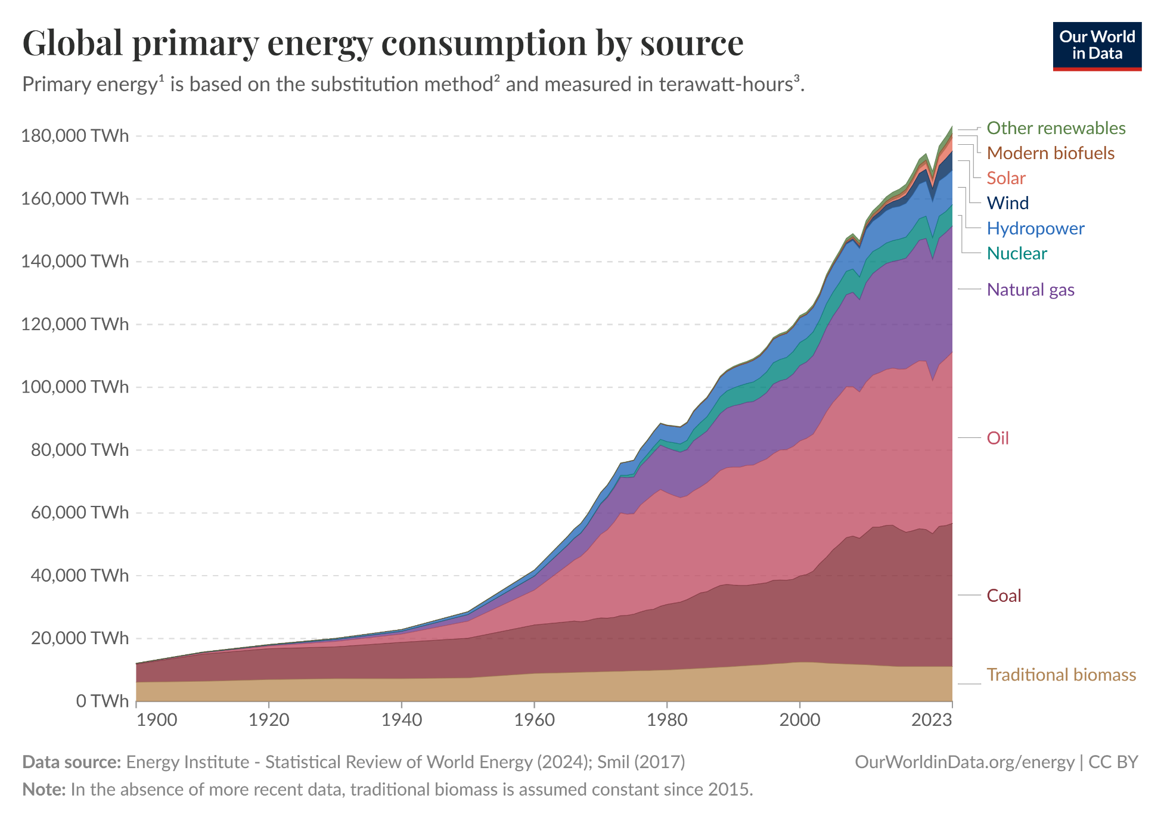

Slide 24
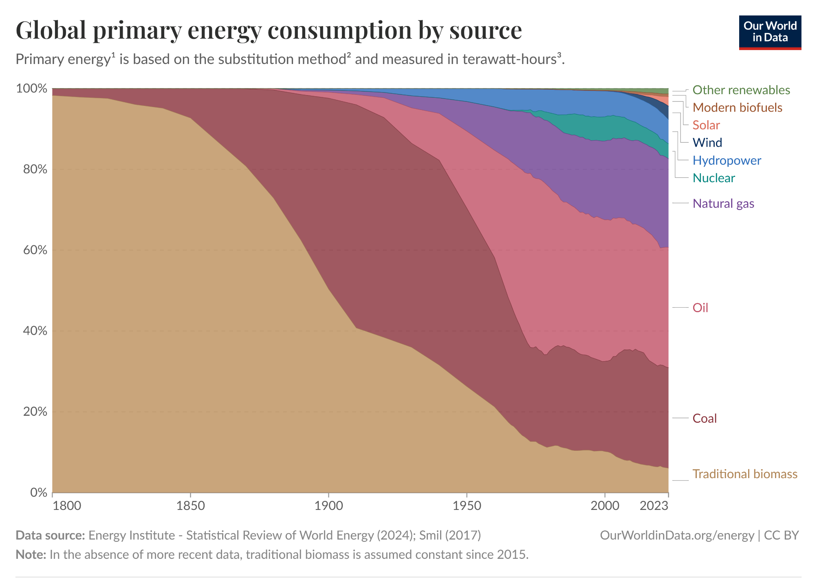
$10 Trillion Invested

Slide 25
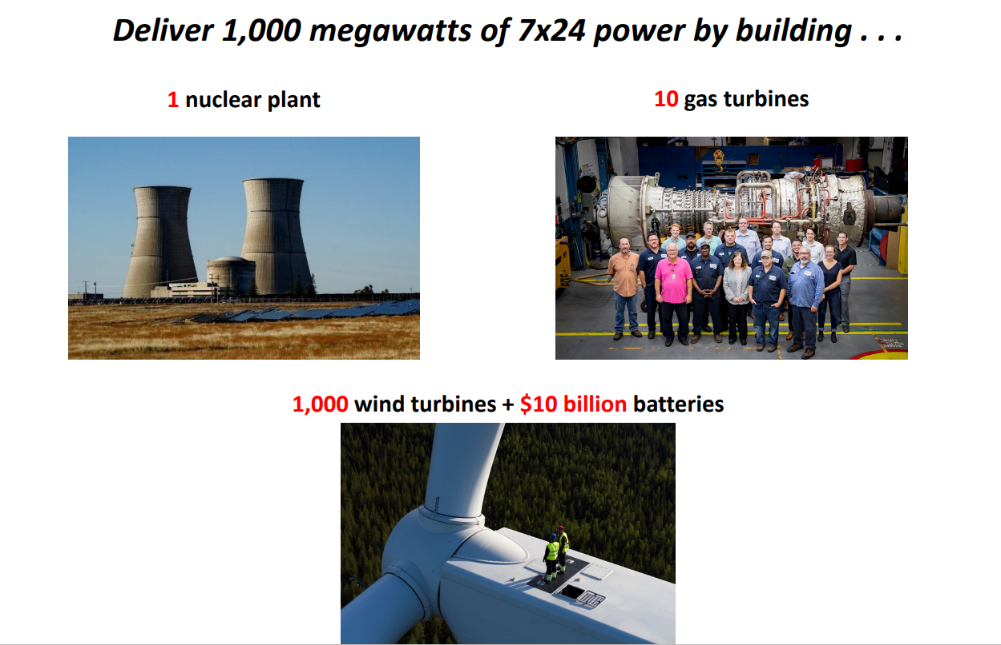
Solar & Wind Are Not Easily Scalable

Slide 26
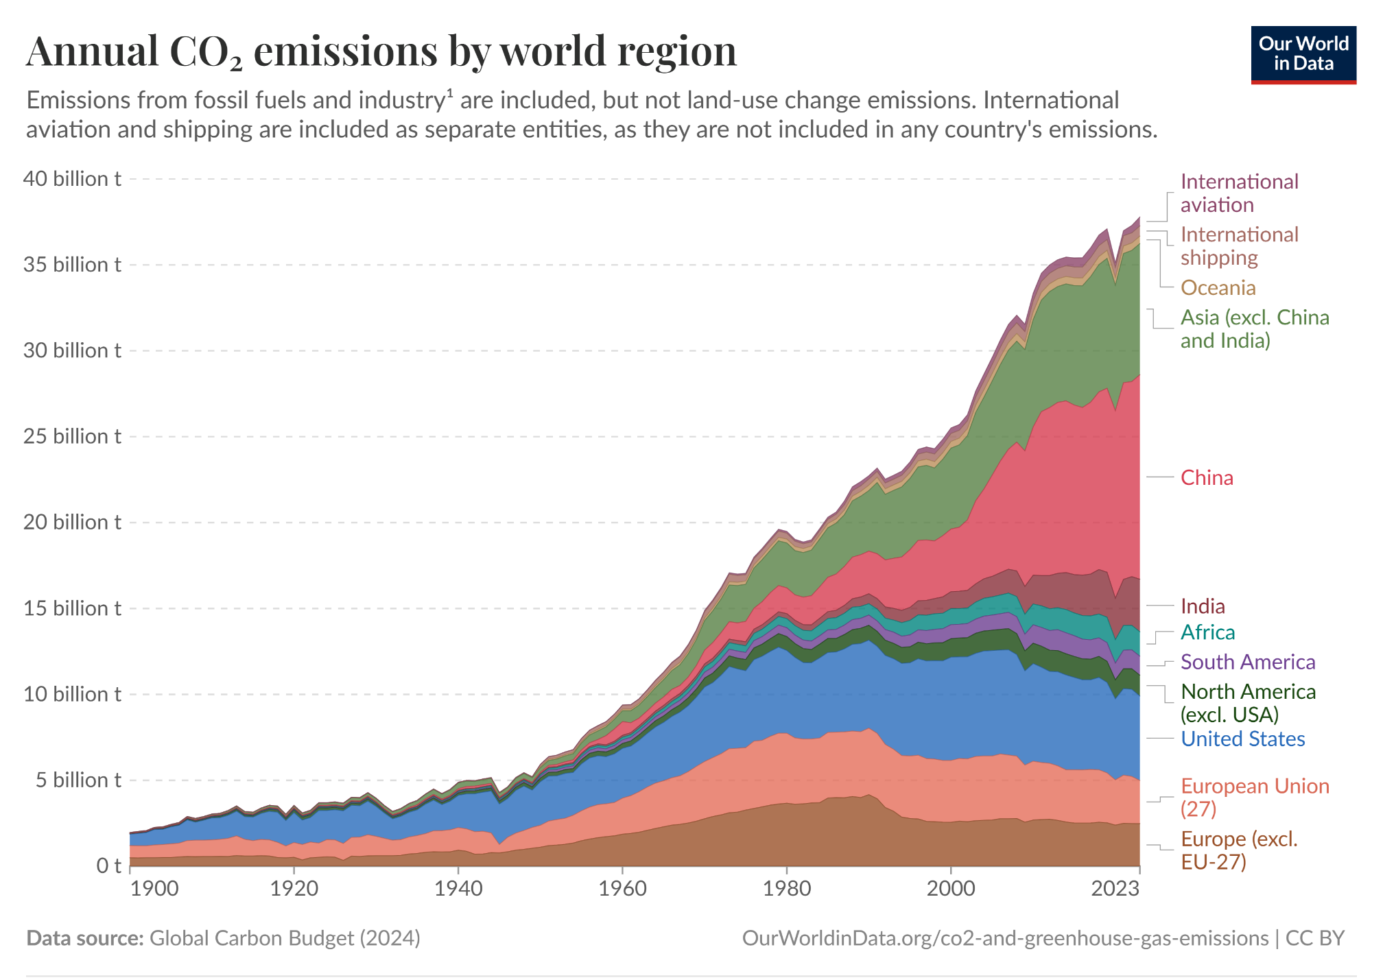

Slide 27
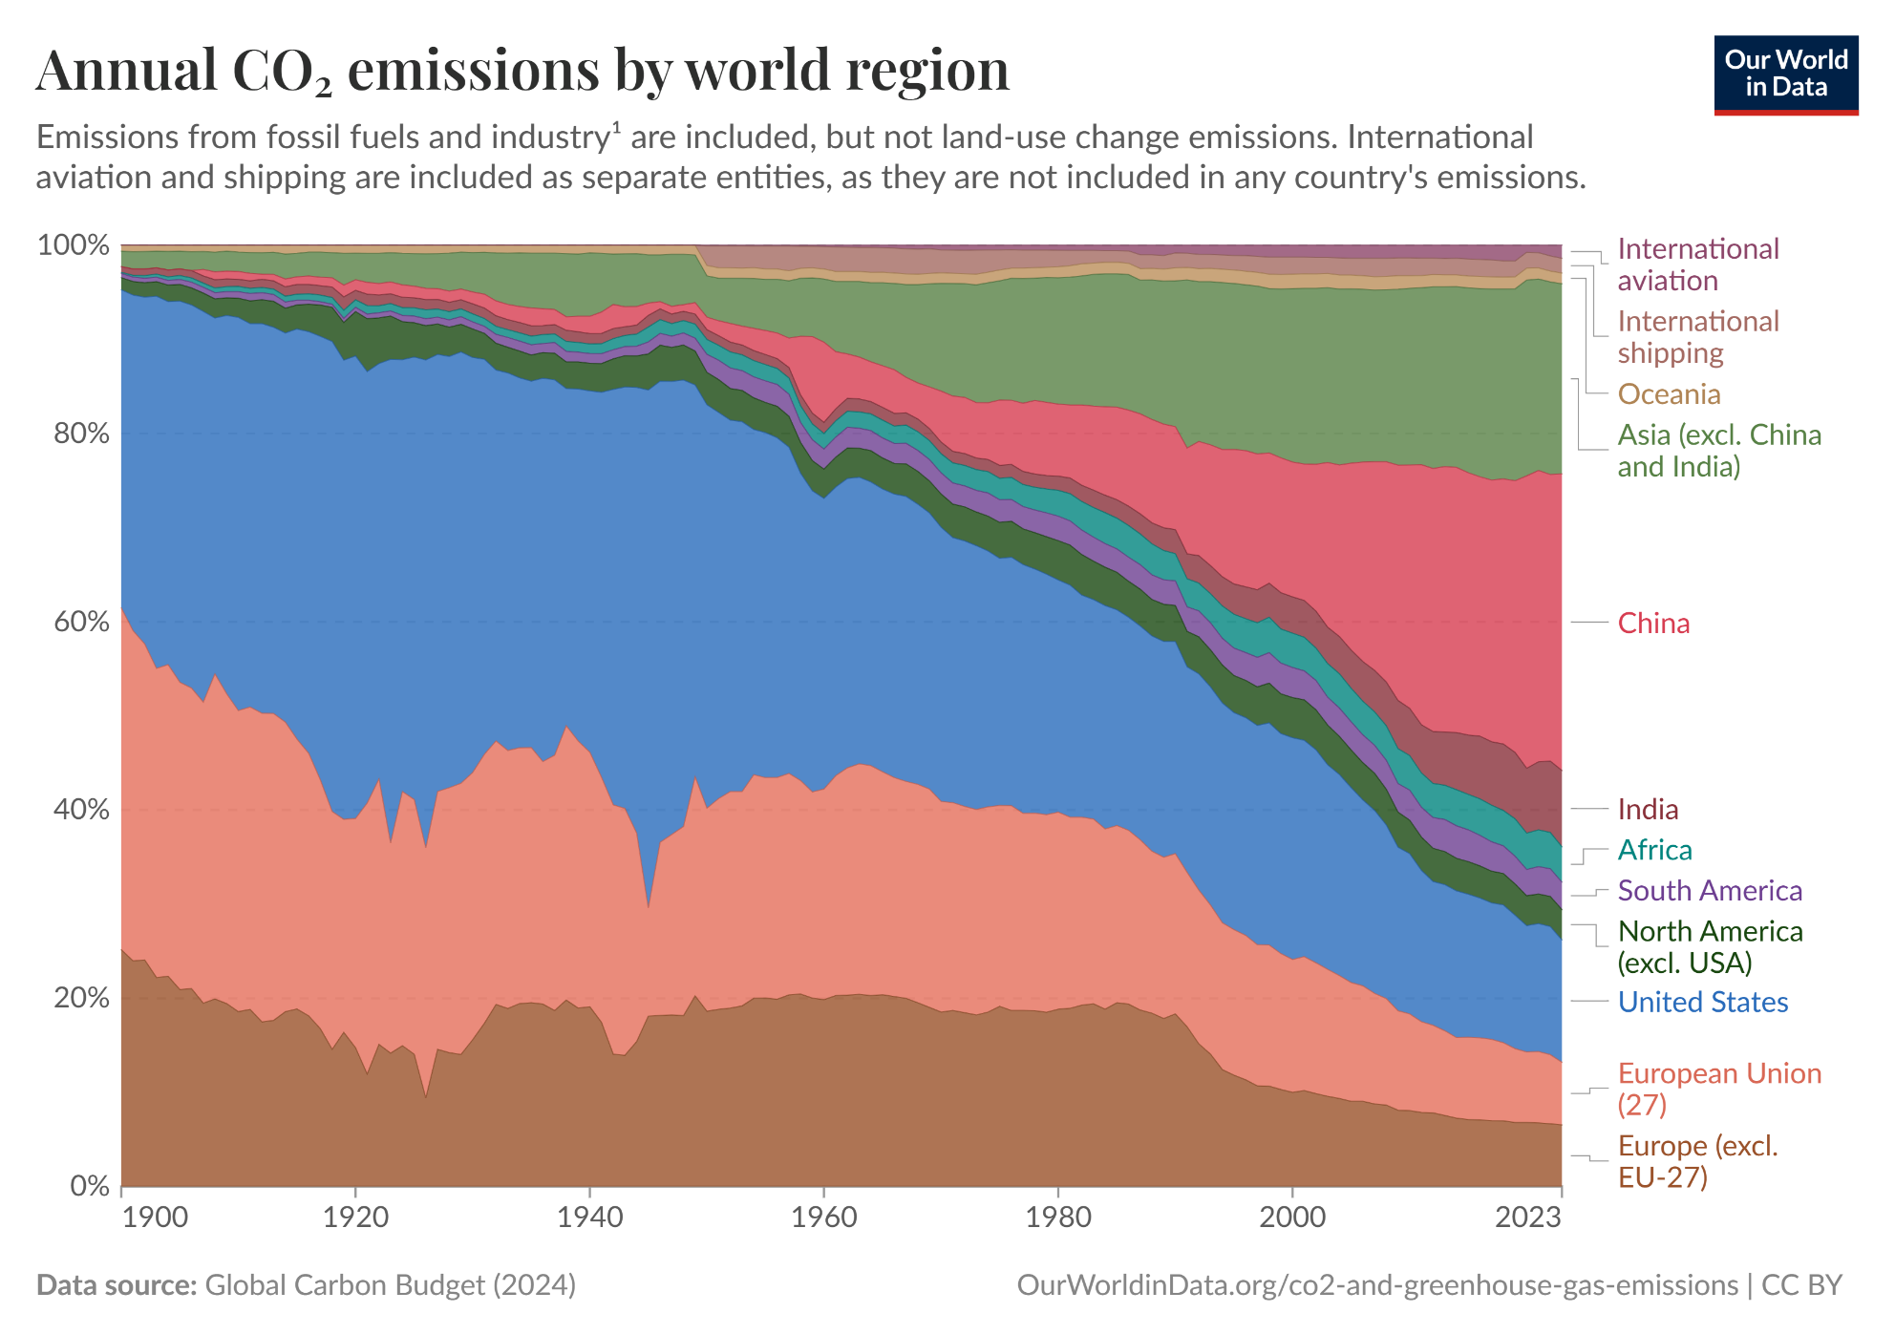
Developing World is 60% of Emissions & Growing
Developing Society’s Compete for Resources
Based on Needs …Not Preferences

Slide 28
Technology is our Evolutionary Super Power
Technology is Power
Energy Feeds Technology
Reliable, Scalable, & Low-Cost are Requirements
Resource Competition Determines Winners
The Losers, like the Neanderthals, will fade away

Slide 29

The world runs on oil. You’re sitting there in your fancy office, typing on your computer, drinking your coffee—all that’s touched by oil. The planes you fly on, the trucks that bring your groceries, the plastics in your phone—oil, oil, oil. You think you can just snap your fingers and replace that? Good luck…
This world doesn’t turn without what we pull out of the dirt. You want to talk about saving the planet? Fine—show me a way to make steel without coal, fly a jet without kerosene, or keep the lights on when the wind don’t blow and the sun don’t shine…
So next time you’re sitting there judging us, sipping your latte, remember this: we’re not the ones dreaming up fairy tales. You want to live in the real world? This is it. Dirty hands, greasy rigs, and all.
Tommy Norris
Midland, TX 2024

