Slide 1

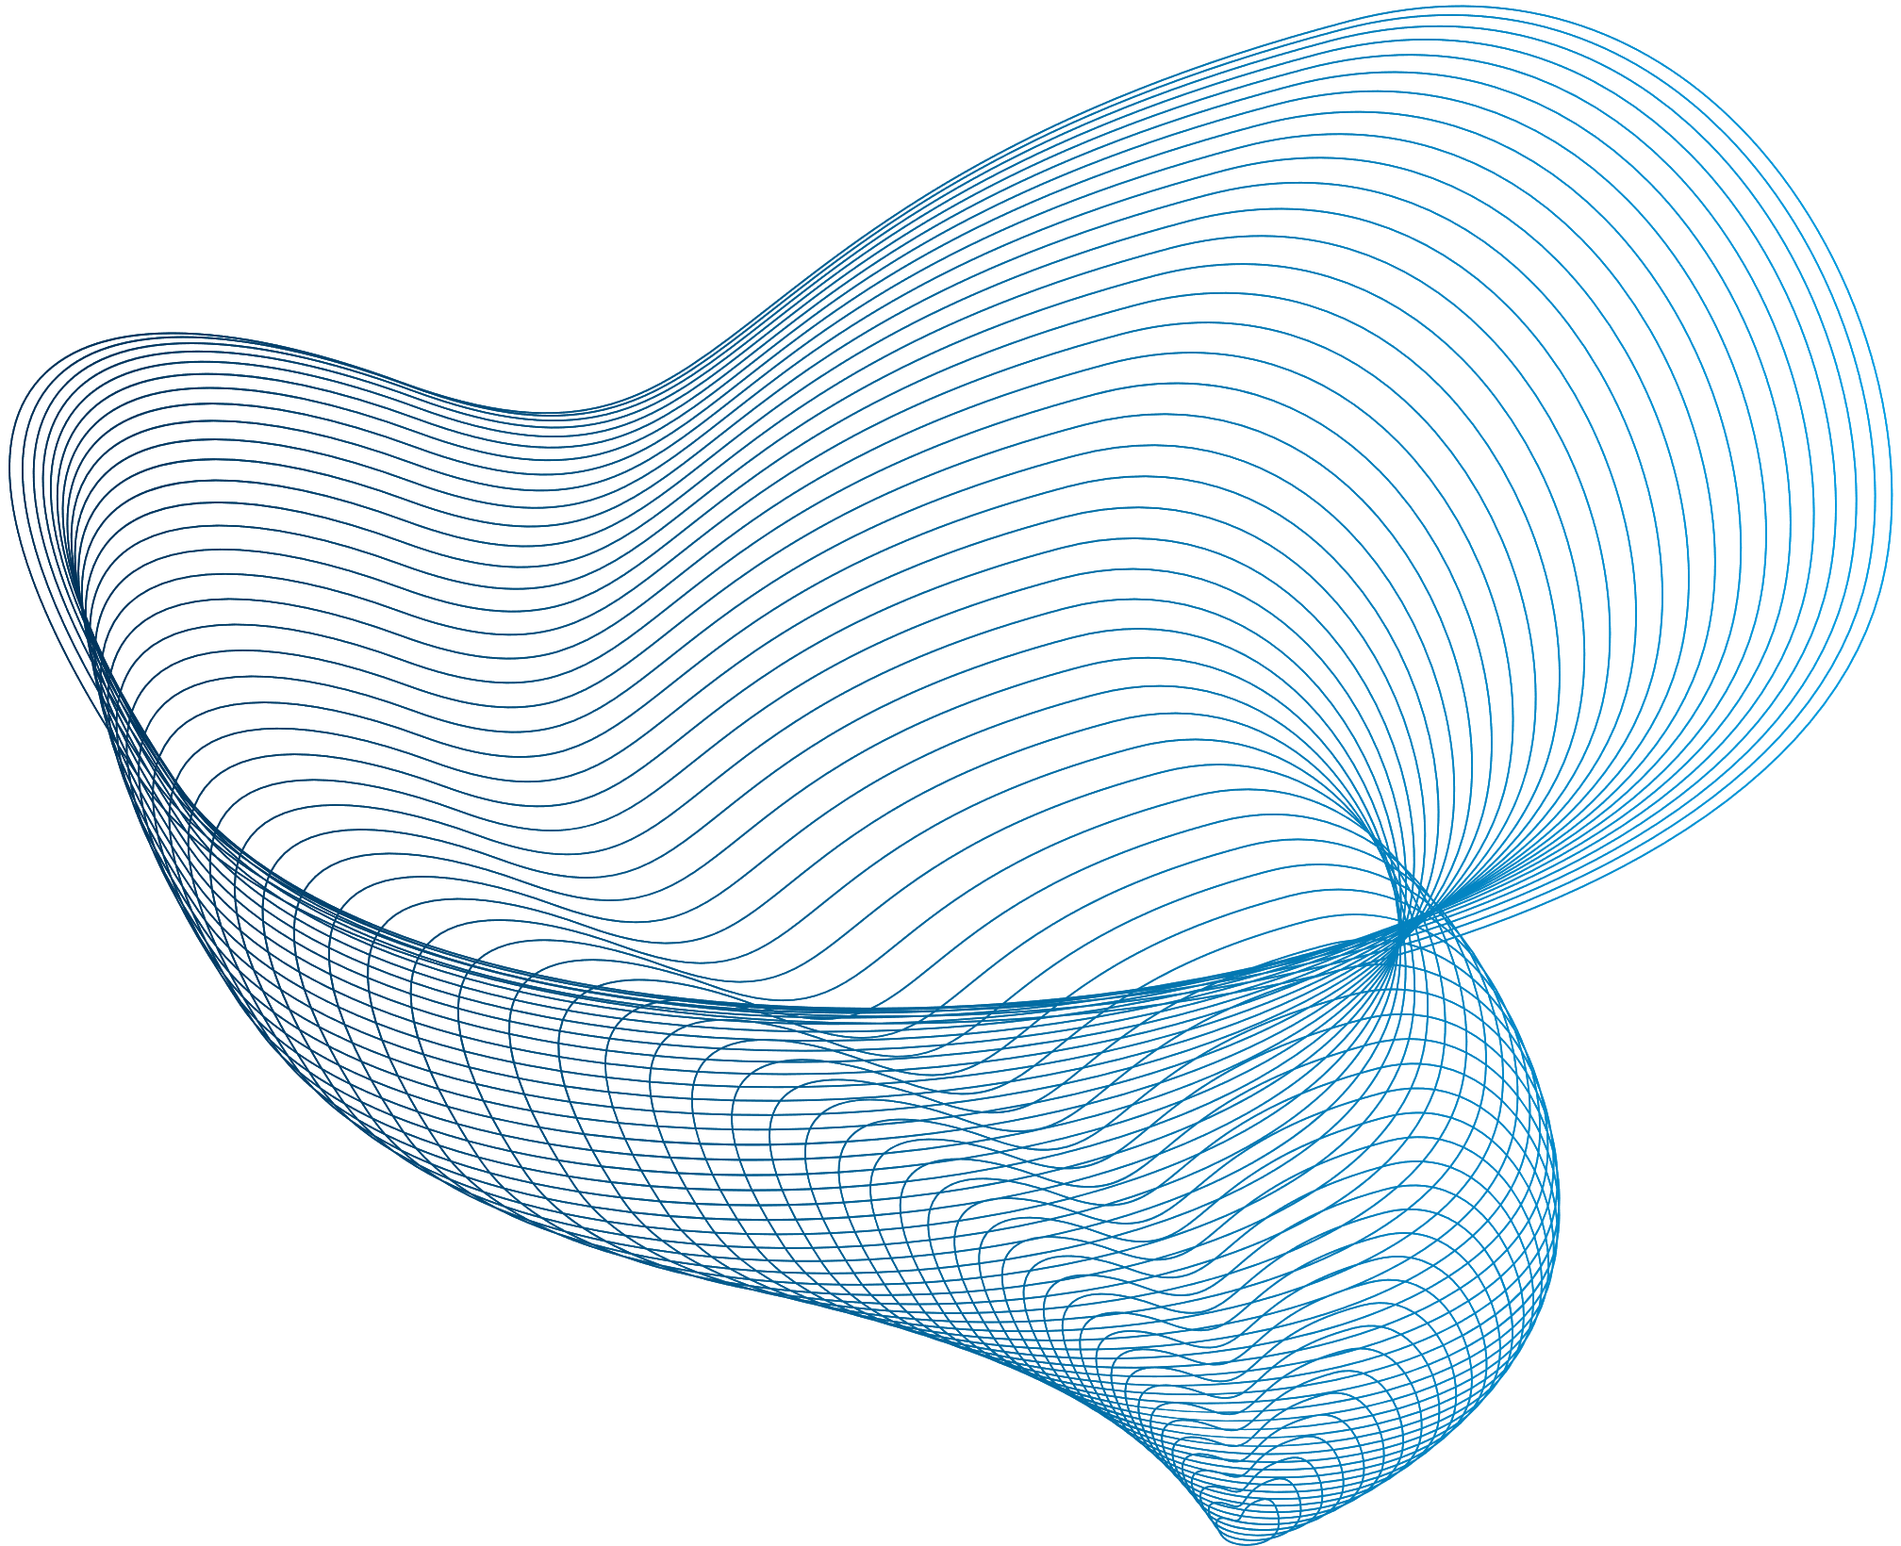
Raising the Bar:
Lessons in Leadership, Resilience, and Excellence
Greg Duplantis
Member, Gordon Arata
PLANO’s Annual Executive Night & Seminar 2025
February 26, 2025

