Slide 1

Louisiana Governmental Update-Plano Executive Night 2025
Michael R. Brassett II
225-490-5003
mbrassett@bradleyfirm.com
301 Main St., Suite 2100 Baton Rouge, LA 70825 bradleyfirm.com
Bradley Murchison Kelly & Shea LLC

Slide 2


Governor Landry’s LDENR Boucherie
Notes:
On February 1, 2024, the governor of the great state of Louisiana, Jeffery M. Landry, signed Executive Order Number JML 24-13 entitled Consolidation of Natural Resources and Energy Related Executive Branch Functions, Powers, Duties, and Responsibilities. I affectionately refer to this order as Landry's Boucherie, it appears that our Governor is attempting to break down the whole hog of state regulatory authority as well as enforcement and compliance, my perspective of these efforts today focuses on the energy industry we all know and love. As the saying goes, pigs get fat, hogs get slaughtered.
The executive order listed a myriad of reasons for reorganization. Rendered down, government has grown too big, we have too many boards and commissions in the State, and we need to increase efficiency, by streamlining, optimizing and modernizing Louisiana government.
Landry’s Boucherie order established an office of enforcement within LDENR for all state and federally delegated programs; it also placed Oil Spill Coordinator’s office under LDENR’s new emergency response functions; and transferred Oilfield Site Restoration to the new Office of Enforcement. The order also created of Natural Resources Finance authority, establishing a Finance Authority to work with the Louisiana Department of Treasury, more to come on this later in my presentation. The governor also asserted a desire to “balance” the CPRA board.
The Landry administration through Secretary Tyler Gray in their outline for the proposed reorganization stated that current job descriptions under civil service prioritize compliance over specific job duties, which often led to misalignment between individual and departmental expectations. Under the reorganization each role within the new department will have a job description that reflects not only compliance, but also detailed responsibilities aligned with each operational track, enhancing the role and providing clarity to the those within the department and the public which will encourage greater accountability and transparency.
This is a huge undertaking as governmental parties have recognized, and their dutiful efforts deserve recognition. This presentation is based upon current understandings of the reorganization and is subject to change, it is a fluid process that has received a Hundreds of public comments from various citizens and NGOs and trade groups with many specifically concerned about merging CPRA into LDENR.
ALLONS!

Slide 3
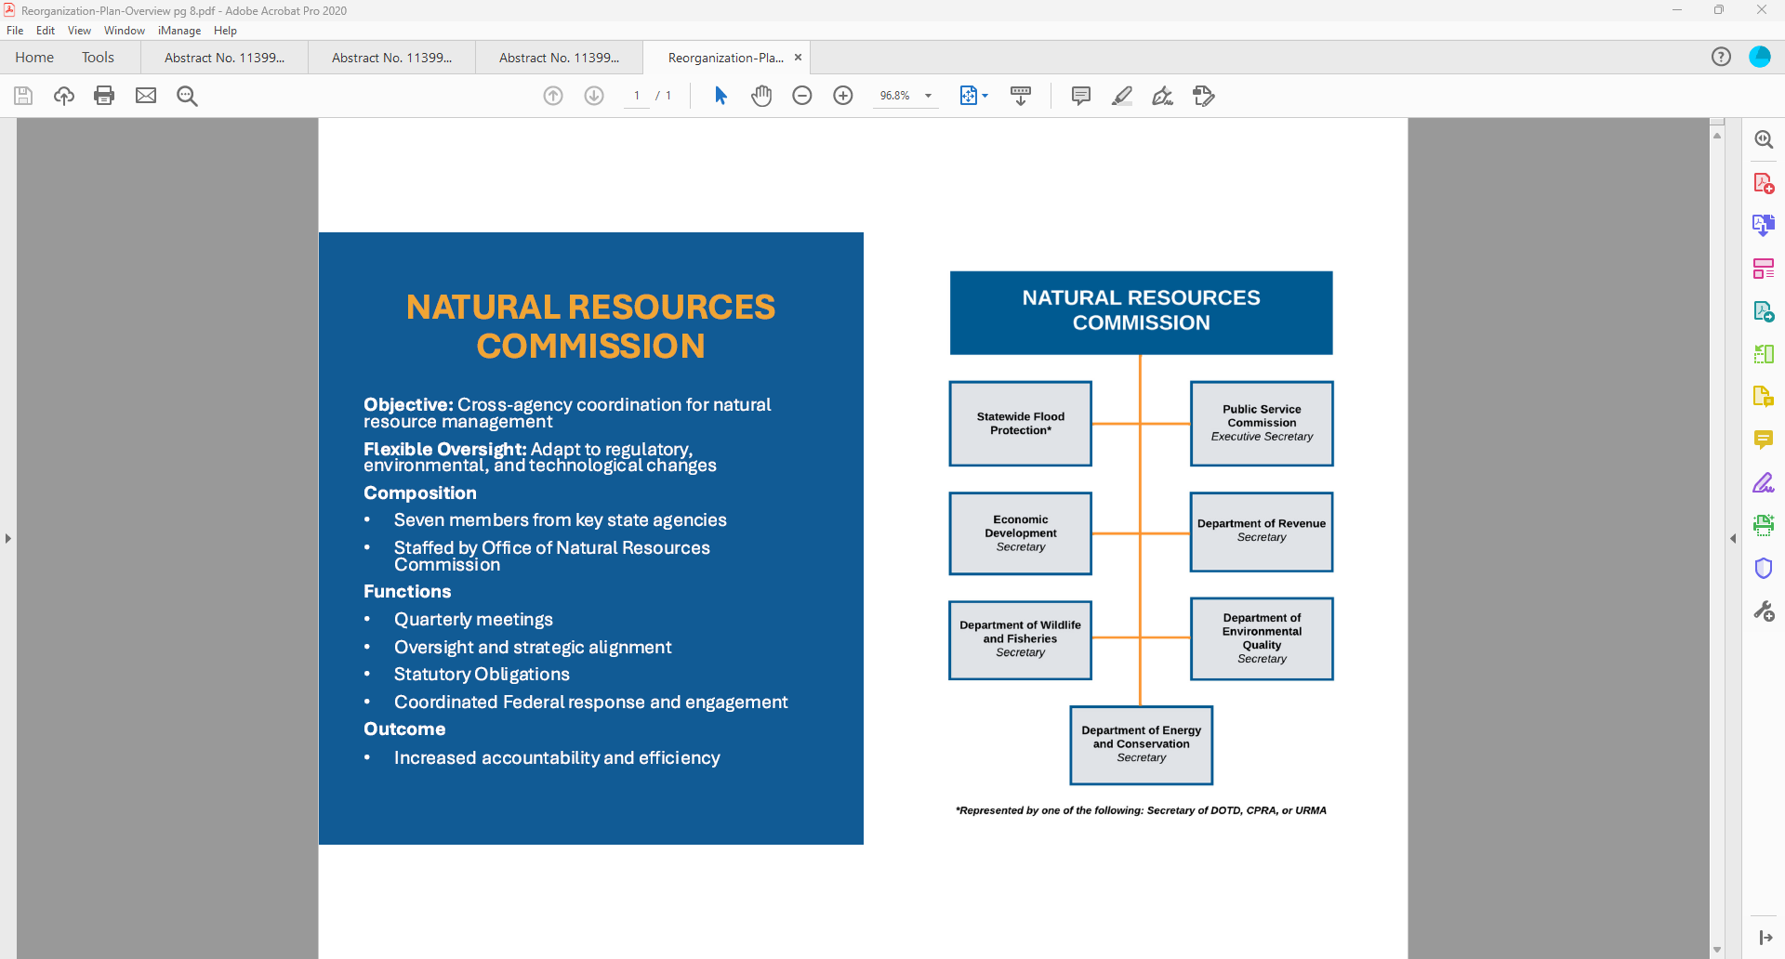
LDENR’s Latest Plan for Consolidation
Notes:
Key components of this reorganization is how authority will be consolidated. LDENR intends to consolidate boards, commissions and task forces. Essentially, setting up DENR to function more under a business structure in pursuit of efficiency while looking past, and growing beyond the reasons these agencies have been historically separated.
Overview
Role: Direct support for Natural Resources Commission and Member agencies
Divisions: Commission Affairs, Intergovernmental Affairs, Communications -A key component of these dynamic frameworks is their ability to respond to external factors, including federal regulations, funding opportunities, and intergovernmental mandates. By establishing a centralized oversight mechanism, the department ensures timely and effective responses to federal overreach when inconsistent with Louisiana policies.
Strategic Functions: Strategic coordination amongst agencies, support via detailed employees, coordinated federal response, investigative and research functions, communications support.
The Office of Natural Resources Commission will be led by the deputy secretary of DENR/ Department of Energy and Conservation and will provide direct support for the Natural Resources Commission. Under the Office of Natural Resources Commission will be: Commission Affairs which will staff, coordinates meetings, manage commission agendas; The Commission Affairs office is to provide administrative support to the Natural Resources Commission, ensuring organizational transparency and strategic alignment. It interfaces with local, state, and federal entities, fostering continuity in collaborative efforts and maintaining accountability in decision making processes. These are their words. In other words, Commission affairs will be the division that interacts with the various levels of government.

Slide 4
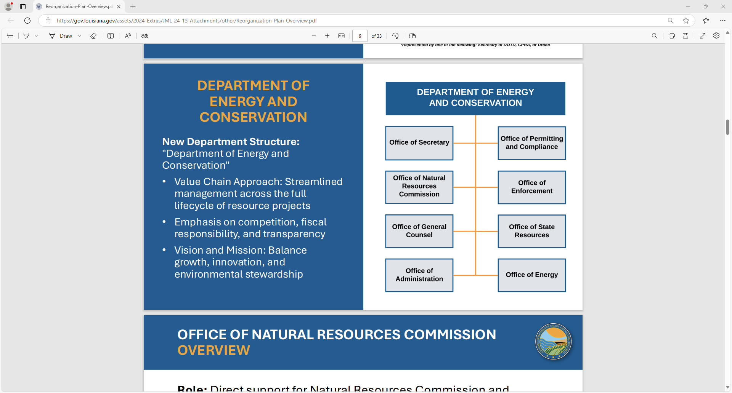
Rebranding DENR to DEC and it’s Structure
Notes:
DENR intends to rebrand themselves as the Department of Energy and Conservation with an emphasis on Conservation.
Their objective in rebranding is to highlight a dual commitment to energy management and environmental stewardship, signaling a new era of resilience and sustainability. Imagine this reorganization being a set of Legos. You have the same building blocks but how you structure your build and the pieces you incorporate and where you incorporate them will have an effect on the whole.
New Entities and Programs
The DRIVE Initiative proposes several new programs and legal entities, as well as changes in assigned duties and tasks amongst existing offices. Several of the proposed changes are highlighted below.
→ Creation of Upland Restoration and Management Authority: This new entity will focus on non-coastal flood protection, risk reduction, and restoration, mirroring the success of the Coastal Protection and Restoration Authority in coastal areas.
→ Expansion of Chief Resilience Officer Role: This position will lead statewide coordination on flood risk mitigation, integrating efforts across agencies for comprehensive resilience planning.
→ Natural Resources Steering Commission: A permanent commission established to provide strategic oversight, foster interagency collaboration, and ensure alignment of statewide resource management strategies.
→ Centralization of Academic Support at the Institute for Energy and Conservation: Focused on research, technological advancement, and public engagement, the IEC will serve as a hub for innovation and collaboration in energy and resource management.
→ Development of Saltwater and Oil Assessment Process: A framework to systematically assess and manage saltwater resulting from commercial operations, including but not limited to, oil-related environmental impacts.
→ Water Resources Management Program: A strategic initiative aimed at sustainable management of Louisiana’s groundwater and surface water resources.
→ Consolidate Power Generation Strategies: Innovative approaches to enhance energy security, optimize generation capacity, and promote renewable energy development.

Slide 5
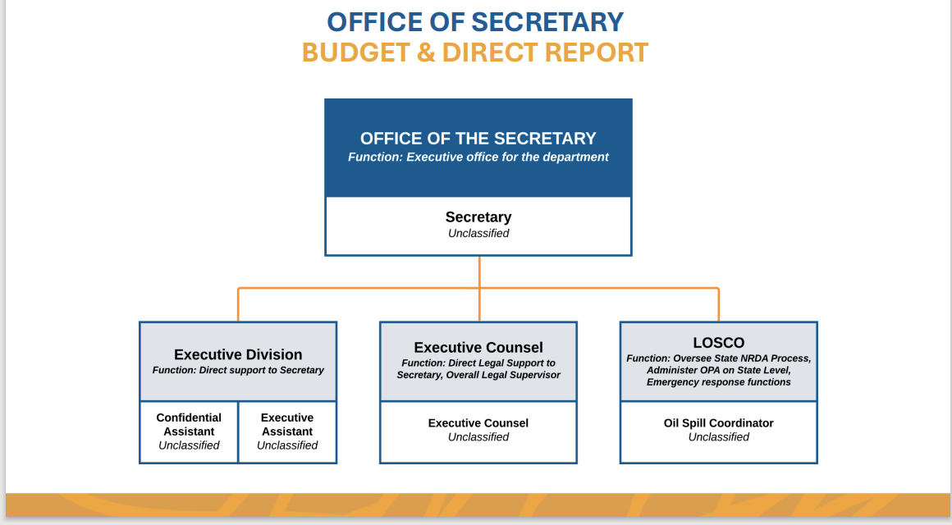
Office of Secretary’s Structure
Notes:
Role: Strategic Management, Emergency Response
Divisions: Executive, Oilfield Site Restoration, LOSCO
Strategic Functions: Overall management support for agency, direct support for Secretary, Oversight of state assessment process and emergency response
Intend to provide leadership, vision, and strategic coordination for the DEC. This also brings LOSCO into the Secretary’s immediate sphere for the stated reason of its coordinating function that operates across multiple departments, offices and divisions necessitates the process.

Slide 6
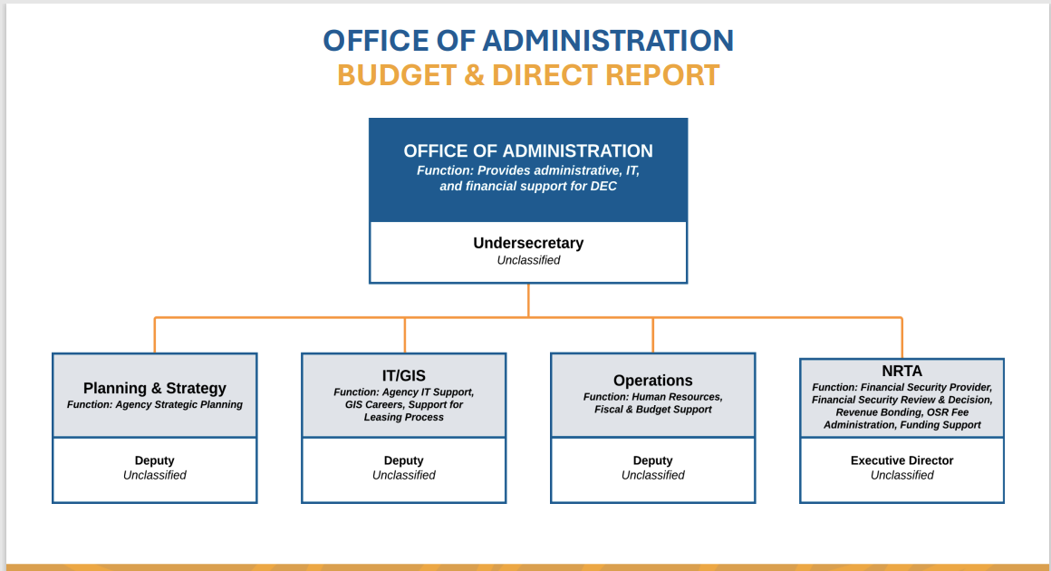
Office of Administration’s Structure
Notes:
The Office of Administration will function as the centralized nexus for all core administrative and strategic operations within the DEC as laid out here. DENR intends to integrate “cutting edge” technologies and foster interdivisional collaboration to enhance operational efficiency, enforce accountability and align departmental activities with their long-term strategic objectives.
Role: Centralized planning and strategic support
Divisions: Trust Authority, IT, Management & Budget(Operations),
Planning & Strategy
Strategic Functions: Oversight of agency operations and Human
Resources, strategic planning initiatives, and budget
Natural Resources Trust Authority
Specializes in strategic financial planning and management, leveraging sophisticated financial modeling tools to allocate funding for high-priority initiatives. By employing predictive analytics and scenario-based financial assessments, the Trust Authority ensures optimal allocation of limited resources.

Slide 7
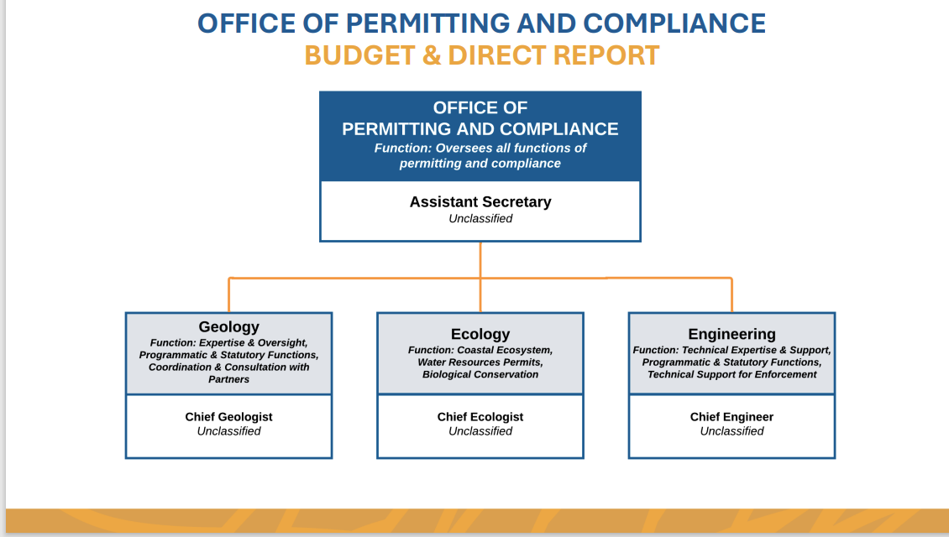
Permit and Compliance Restructure
Notes:
The Office of Permitting and Compliance (OPC) within the reorganized DEC represents a New approach DENR calls transformative. Historically, permitting responsibilities were distributed across the Office of Coastal Management (OCM) and the Office of Conservation, creating what DENR terms as potential overlaps and inefficiencies. This combination of offices and permitting may affect jurisprudence and a change to administrative procedure ultimately leading to permit challenges.
Historically, the Louisiana Department of Conservation has handled permitting and compliance of oil and gas activities. Being charged with conserving and regulating oil, gas, pipelines and lignite resources of the state. Now that authority is being rolled up into what will be the newly formed DEC (previously LDENR). We all can probably rattle off the different divisions within Conservation that play key roles in our businesses:
Executive, Engineering admin,
Engineering regulatory, Environmental,
Geological Oil & Gas,
Injection and Mining, and Pipeline.
It now appears that the executive of conservation, the commissioner is not a specific role brought forward, and the executive will be an assistant secretary. Further, there will be a narrowing of the divisions to only three being, engineering, geology, and ecology. The Office of Coastal Management will also be rolled up into this new department. This could prove to be problematic, as the public grapples with this new structure, it may result in increased challenges on regulatory permits. For example, the federal and state government has seen an increase in permit challenges for what amounts to climate change. Courts have found climate change to be outside the scope of authority of the OCM as it is an agency that only has the authority to regulate the coastal zone. It is up to chance what will happen if regulatory authority of LDENR/ DEC broadens.
The only place the commissioner of conservation is listed in the document presented by LDENR in November is within the statutes for authority. Enforcement will still be handled by a separate Office.

Slide 8
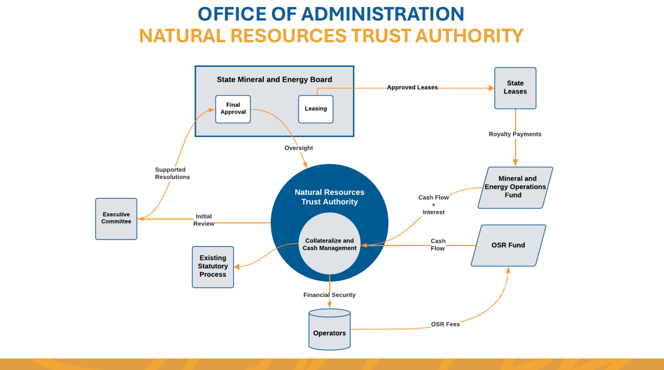
Natural Resources Trust Authority
Notes:
The Natural Resources Trust Authority will Specialize in strategic financial planning and management, leveraging sophisticated financial modeling tools to allocate funding for high-priority initiatives. By employing predictive analytics and scenario-based financial assessments, the Trust Authority ensures optimal allocation of limited resources.
Collaboration
Maintains synergistic relationships with the Mineral Board, State Bond Commission, and Louisiana Department of Treasury, while also pursuing co-financing opportunities with other finance authorities. These partnerships enable comprehensive financial strategies that balance immediate needs with long-term objectives.
Rulemaking & Compliance
Develops regulatory frameworks under the Administrative Procedure Act, engages public input, and conducts audits to ensure adherence to governance standards. The Trust Authority also integrates stakeholder feedback to enhance transparency and inclusivity in financial decision-making.
Considerations
Potential strategies to achieve these objectives include introducing regulations enabling the Trust Authority to leverage federal funding for loan programs aimed at enhancing energy reliability and reducing consumer costs.

Slide 9
Where are we now ?
This reorganization effort has placed a emphasis on the promotion of efficiency and downsizing government.
The reorganization effort also intends to utilize IT tools to streamline all of its processes.
A potential problem this may cause for industry and specifically operators is how this action and potential legislation will affect judicial precedent.
Notes:
A potential problem that this may cause for industry and specifically operators is how this action and potential legislation will effect judicial precedent. Specifically, M.J. Farms, Ltd. v. Exxon Mobil Corp., 2007-2371 (La. 7/1/08), 998 So. 2d 16, amended on reh'g (Sept. 19, 2008). A critical argument in M.J. Farms, Ltd. v. Exxon Mobil Corp case in 2008 was the structure of the agencies allowing act 312 to be determined to be constitutional the way it is currently written.
Although statute changed the remedy available to property owner in its efforts to obtain surface restoration of its immovable property, district court remained an active participant in the entire restoration process, and it would be determined in the district court whether environmental damages existed, who had caused the damage, and would be for district court to order the development of a restoration plan. M.J. Farms, Ltd. v. Exxon Mobil Corp., Sup.2008, 998 So.2d 16, 2007-2371 (La. 7/1/08), amended on rehearing.

Slide 10
Thank you.
Michael R. Brassett II
225-490-5003
mbrassett@bradleyfirm.com
301 Main St., Suite 2100 Baton Rouge, LA 70825 bradleyfirm.com
Bradley Murchison Kelly & Shea LLC
Notes:
Everyone thank you for your time. If you have any questions and concerns please feel free to contact me at the provided email and phone number.

